Slide 1
From Cloud to on-premises: Working with LLM, SLM and more
Wai Man Hui
Partner Solution Architect
Shing Lee
Partner Solution Architect

Slide 2
Agenda
1
Tools for running LLM and SLM in Hybrid environment
2
Cost Estimation
4
Latest Update
5
GenAI Ops
6
GenAI Security

Slide 3




Microsoft AI tooling and services
Best-in-class AI foundation models
Azure AI Services
Pre-trained, turnkey solutions for intelligent applications
Azure Machine Learning
Full-lifecycle tools for designing and managing AI models
Responsible AI Tooling
Build and manage apps that are trustworthy by design
Azure AI Studio
AI Toolkit for VS Code
A comprehensive platform to develop and deploy custom copilots
End-to-end AI Developer toolkit download, finetune, deploy

Slide 4














Access to the latest open-source & foundational models
Full-lifecycle measurement
Cohere Family
Performance, low-latency
and built-in grounding
Mistral Family
Exceptional language and multilingual reasoning
Meta Family
Use case versatility,
open ethos and safety
Stability AI Family
Robust image generation
models like Stable Diffusion
Prototype
Identify promising models based on benchmarking with public data
Microsoft Family
Cost-effective, domain-
specific SLM efficiency
Nvidia Family
High-quality, reliability and designed for optimization
Optimize
Test prompts and iterate
with manual evaluations, using small data sets
Azure OpenAI Family
Multimodal GenAI, privacy, security and enterprise scale
Model Catalog
Databricks Family
Expertise in enterprise workloads and databases
Operationalize
Measure the quality and safety more broadly with automated evaluations
Hugging Face Family
Open-source options that are accessible and adaptable
Snowflake Family
Cost-effective training, helpful coding and resources

Slide 5
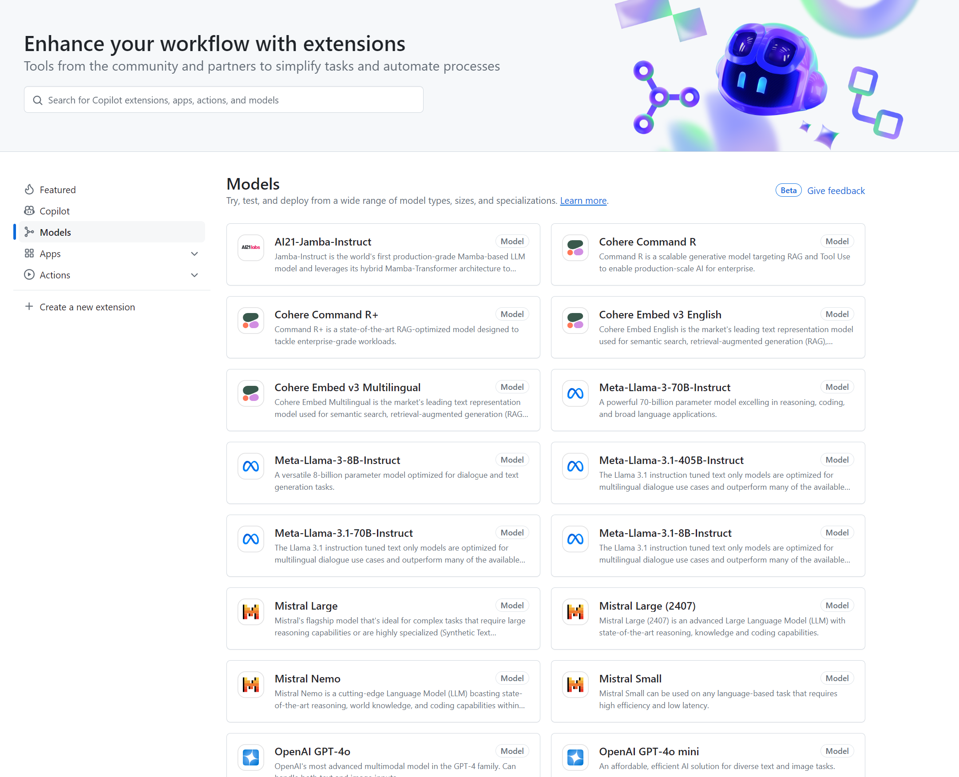
GitHub Model Card and Playground
https://gh.io/models

Slide 6
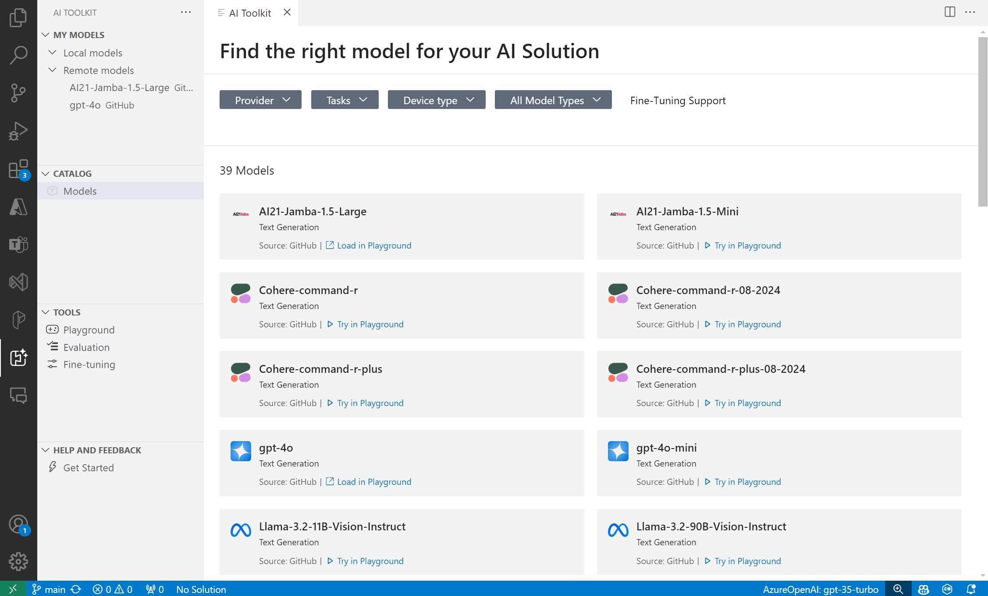
AI Toolkit for VS Code

Slide 7
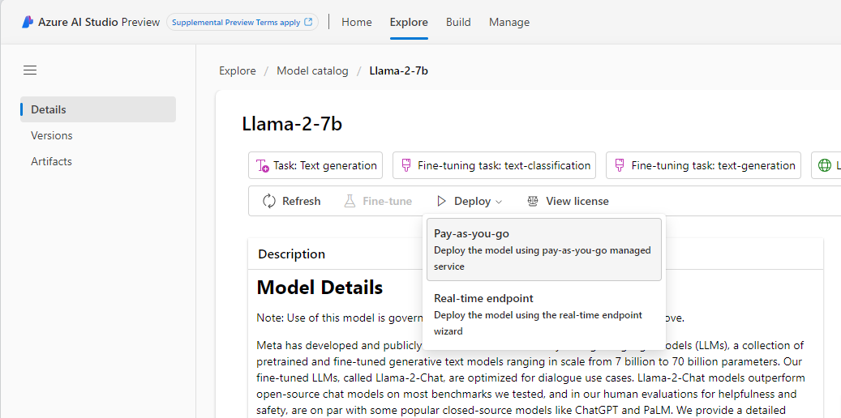
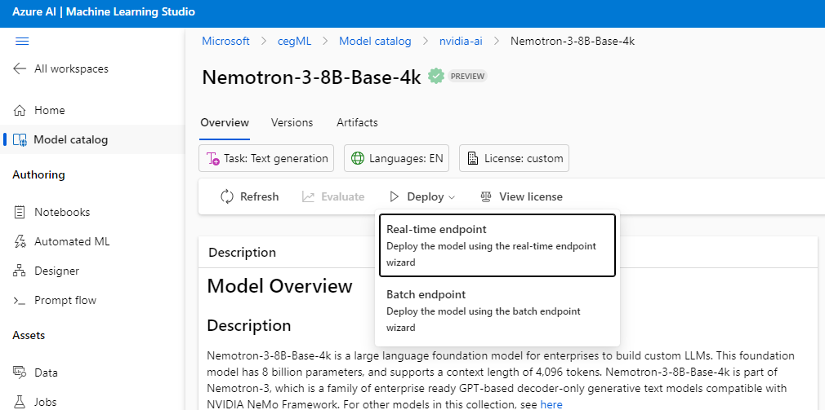
Azure Machine Learning. Azure AI Studio model catalog
Serverless API (Models-as-a-Service)
Less hassle with managed services
Managed Compute (Models-as-a-Platform)
More options with greater responsibility
Ensured data privacy with both options
Microsoft does not share customer data with model providers. Customer data is anonymized and aggregated.

Slide 8
Local Data Residency Concern
Azure OpenAI & Azure AI Studio
Not support deployment to East Asia
Azure Machine Learning Studio
Support deployment to East Asia
Model Catalog Serverless API deployment either not supported in East Asia or HK subscription
Phi-3, Phi-3.5, Mistral, Nixtla TimeGEN-1
Not supported in East Asia
Llama, AI21-Jamba, JAIS, Cohere
Marketplace models currently supported marketplace managed regions only: Microsoft Managed Regions
Will gradually support but no ETA
Model Catalog Managed Compute preset list of sizing does not support in East Asia
=>Azure Machine Learning Studio Manual deployment

Slide 9
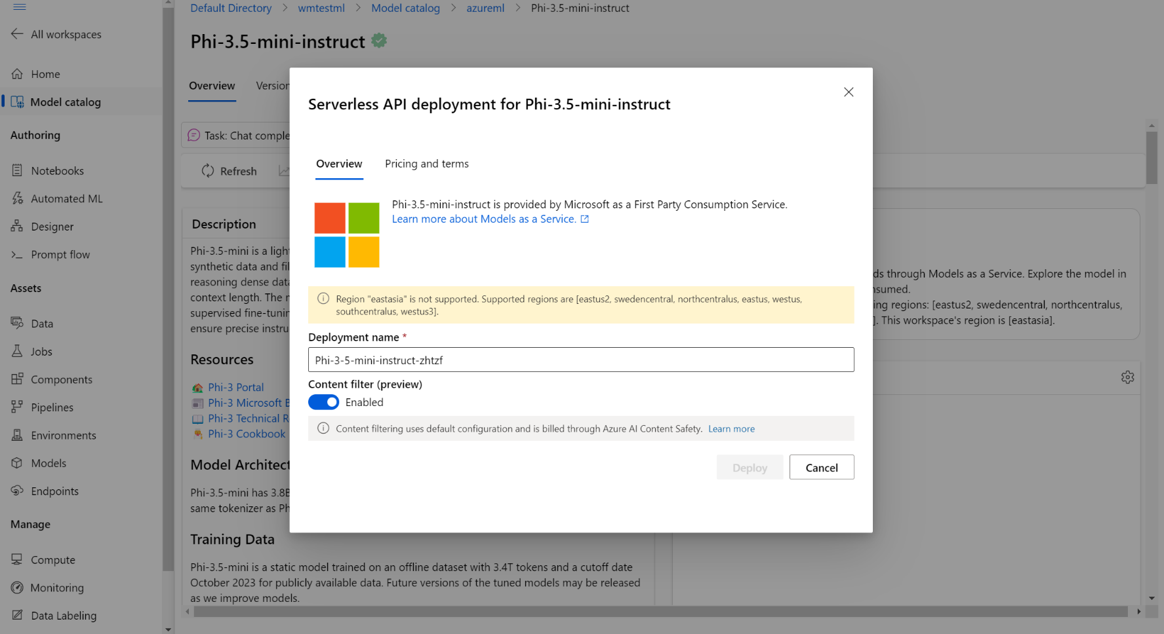
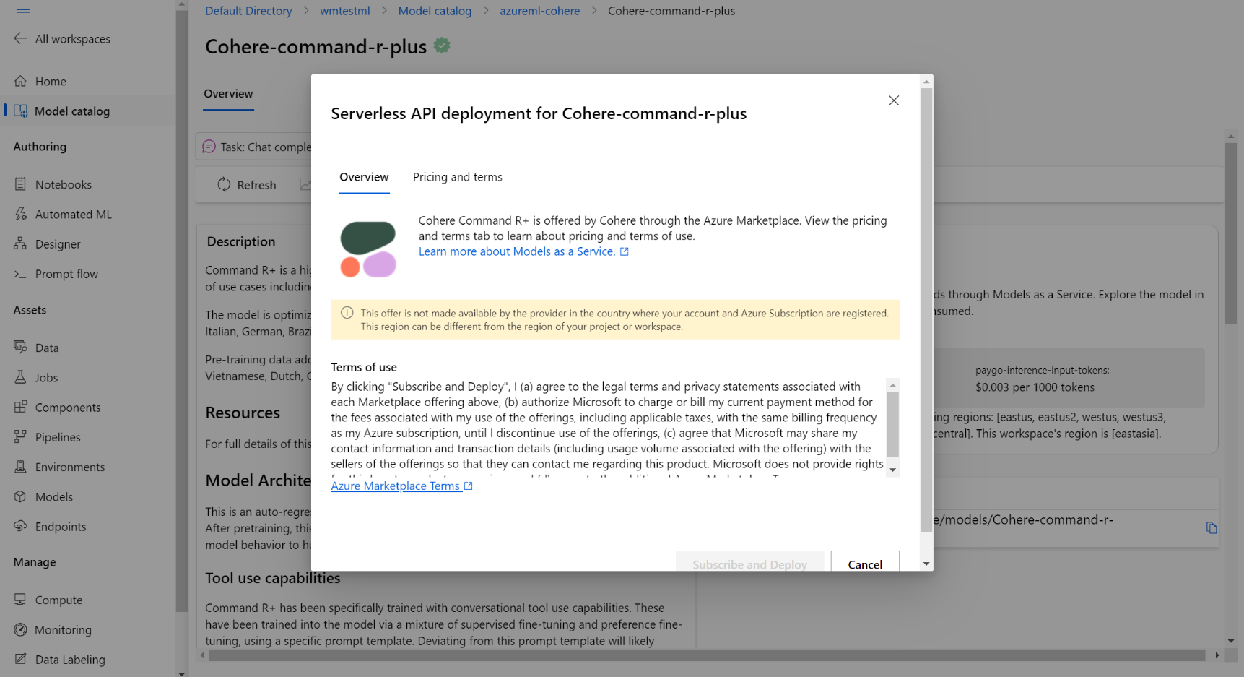
Model Catalog Serverless API

Slide 10
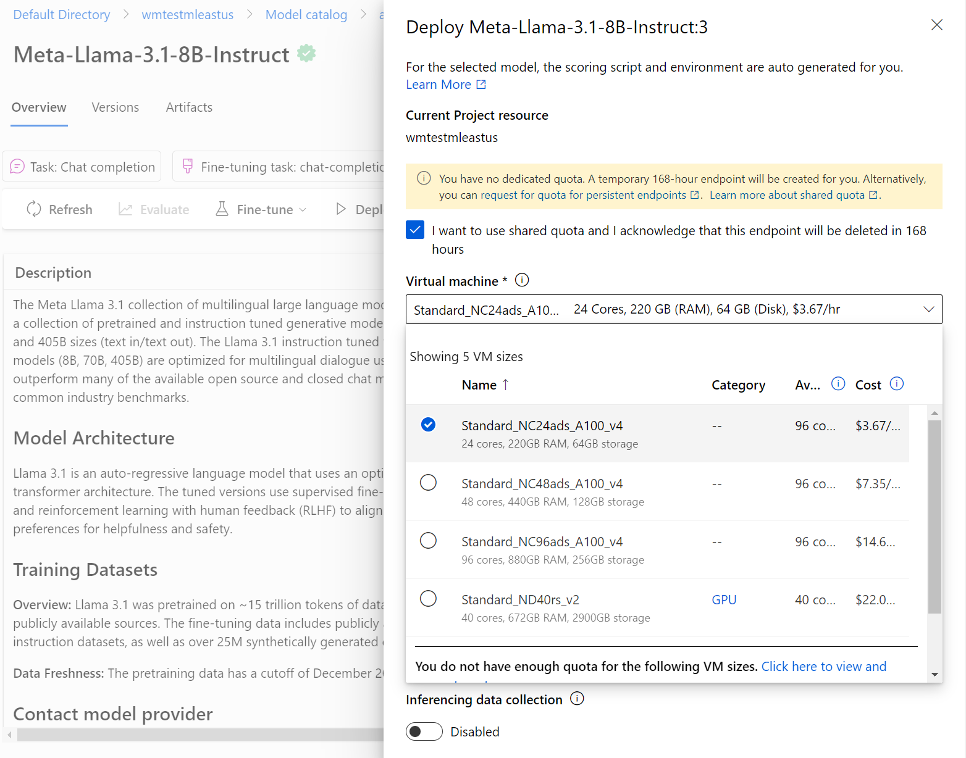
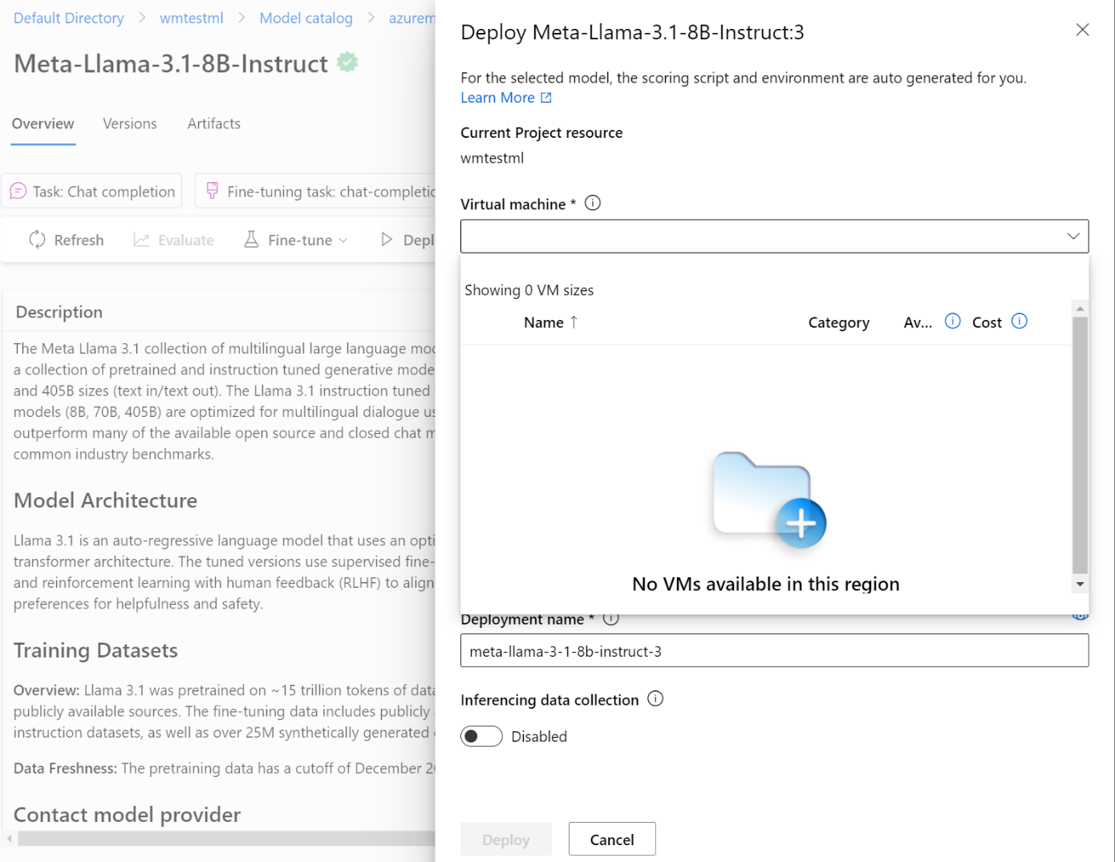
Model Catalog Managed Compute
East US
East Asia

Slide 11
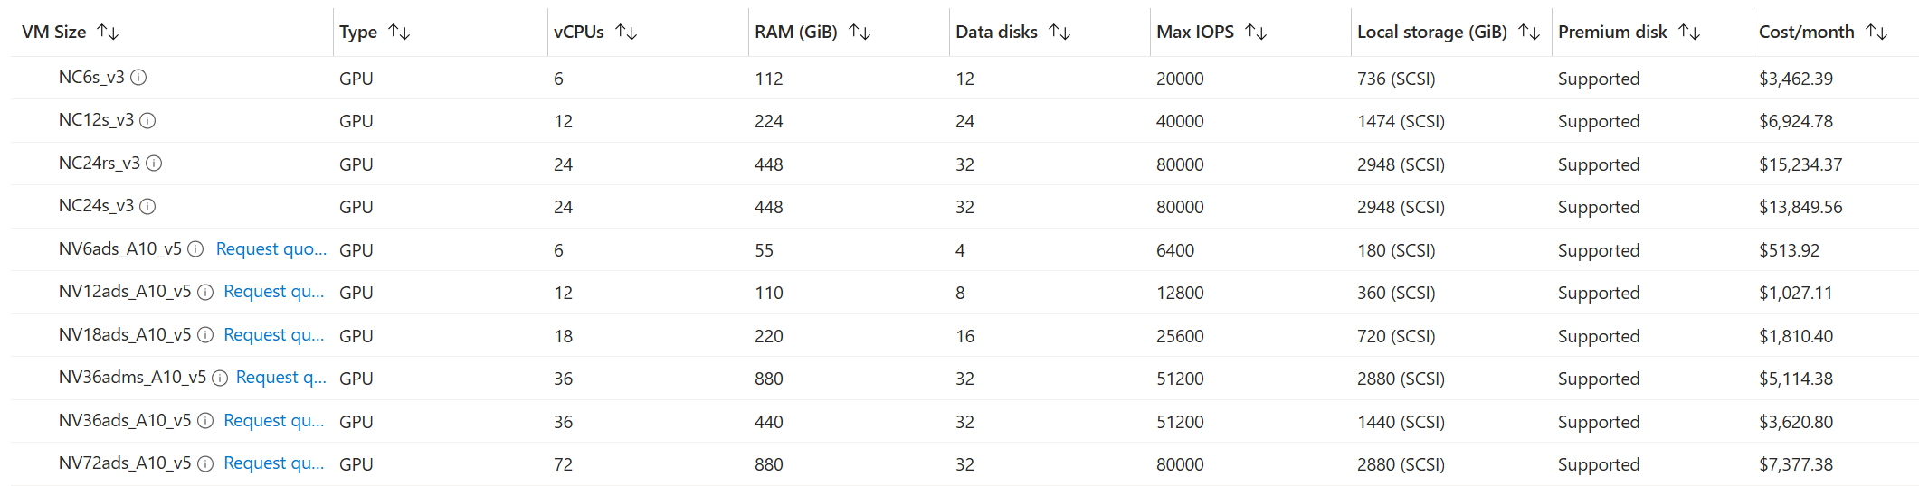
Supported GPU sizing in East Asia
Supported in Azure Machine Learning Managed Compute

Slide 12
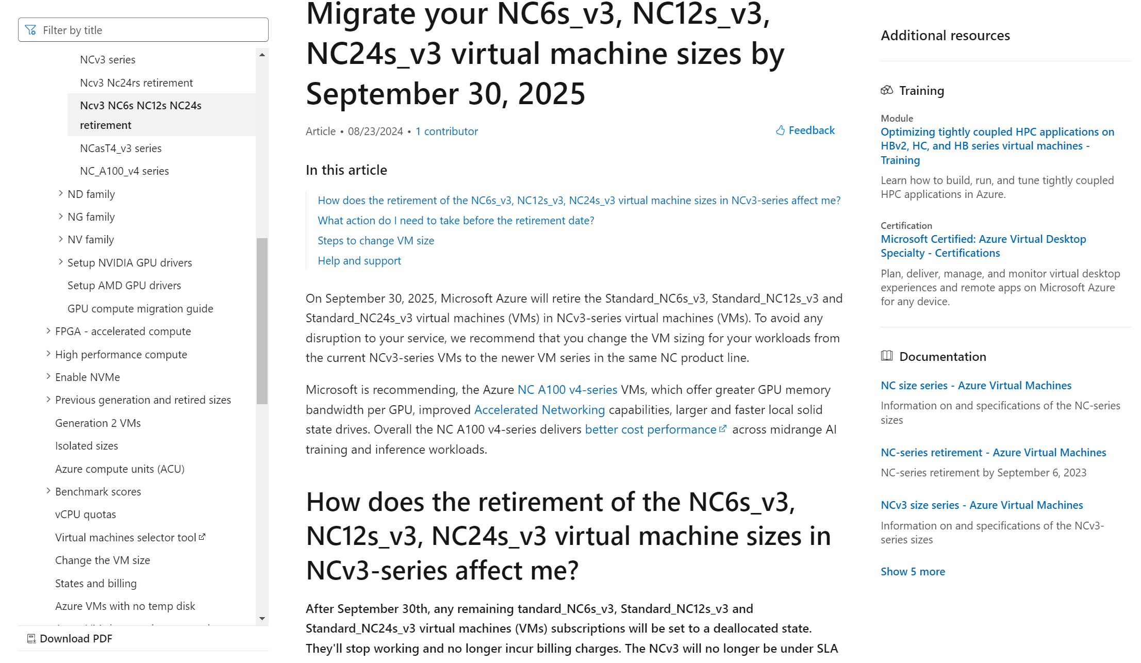
Upcoming Retirement
NCv3 and NC6s NC12s NC24s Retirement

Slide 13
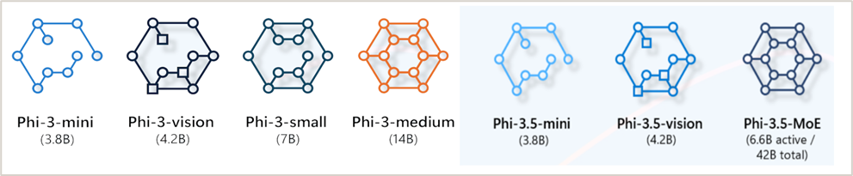





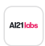
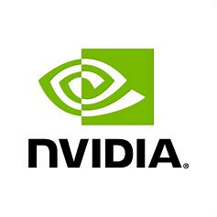
Models are advancing and offering new ways to AI
Small Language Models (SLMs)
Large Language Models (LMMs)
Small language models (SLMs) are a viable alternative, offering domain-specific capabilities with greater compute efficiency
Large language models (LLMs) have become widely recognized beyond tech circles due to their transformative impact over the past year
Efficient
Domain-specific
Low compute
Contextual
Versatile use cases
High compute

Slide 14
Comparison of SLMs vs LLMs
Small Language Models (SLMs)
Large Language Models (LMMs)
Characteristics
Characteristics
Fewer parameters (e.g., models with millions of parameters)
Less computationally intensive
Simpler architecture
High number of parameters (e.g., GPT-4 with 175 billion parameters)
Requires significant computational resources
Capable of understanding and generating complex and nuanced text
Advantages
Advantages
Faster training and inference times
Lower computational and energy costs
Easier to deploy on edge devices
Superior performance in diverse NLP tasks
Better at understanding context and generating coherent responses
Can handle a wide range of languages and dialects
Disadvantages
Disadvantages
Limited performance on complex tasks
Less capable of understanding context and generating nuanced text
May struggle with diverse languages and dialects
High computational cost and energy consumption
Longer training times
Requires large datasets for training

Slide 15
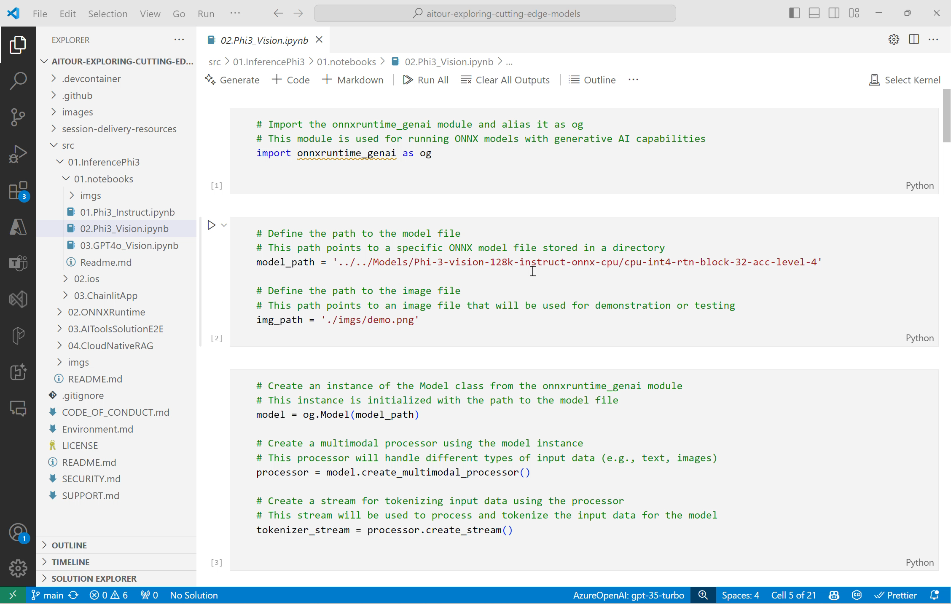

Slide 16














Machine Learning platform architecture
Azure ML
Seamless studio experience
Structured Data
Business Apps
Notebooks
Automated ML
Designer
Responsible ML tools
Comprehensive MLOps
Models: AKS
Batch predictions: SQL DB
Open Datasets
Reproducibility
Automation
Deployment
Re-training
Unstructured Data
Security and Governance
Analytics
Unified management across clouds and on-premises
Azure
Edge & Hybrid
Data Bricks
Synapse
Power BI
All other ML scenarios; NLP, Vision, IoT, etc.
Serverless
Compute
Managed
Kubernetes
Azure Arc-enabled
Kubernetes
Edge/IoT Devices
AI-first toolchain
Prepare Data
Build & Train
Deploy
Manage & Monitor

Slide 17
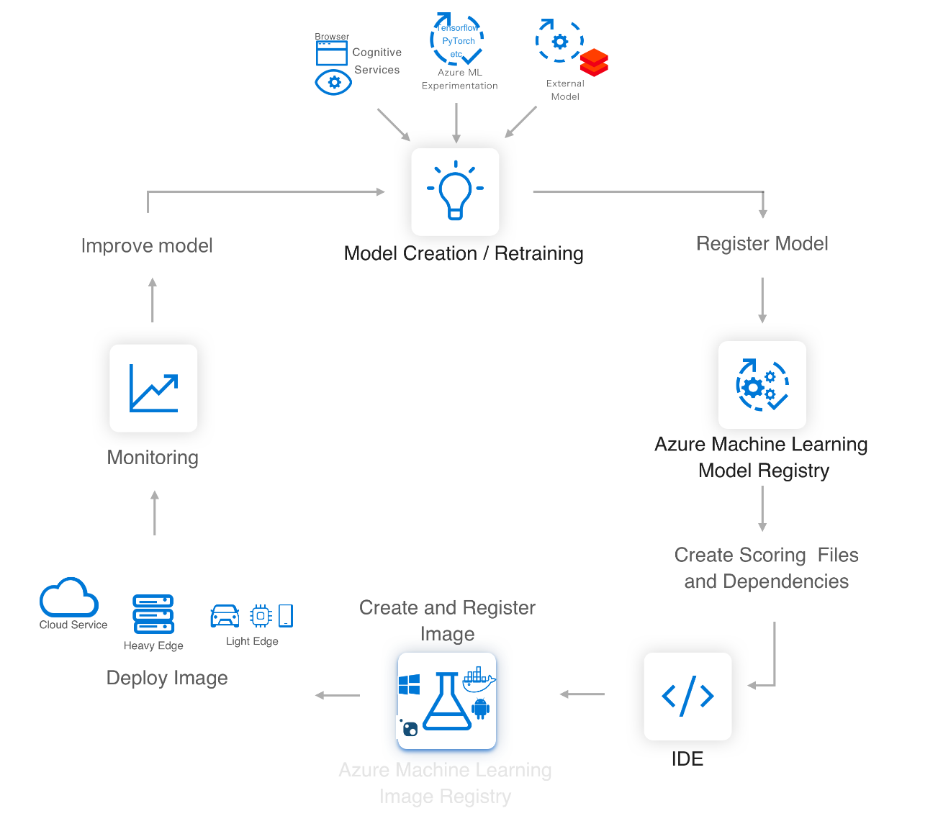

Azure ML service
Lets you easily implement this AI/ML Lifecycle
Workflow Steps
Develop machine learning training scripts in Python.
Create and configure a compute target.
Submit the scripts to the configured compute target to run in that environment. During training, the compute target stores run records to a datastore. There the records are saved to an experiment.
Query the experiment for logged metrics from the current and past runs. If the metrics do not indicate a desired outcome, loop back to step 1 and iterate on your scripts.
Once a satisfactory run is found, register the persisted model in the model registry.
Develop a scoring script.
Create an Image and register it in the image registry.
Deploy the image as a web service in Azure.
Azure Machine Learning

Slide 18
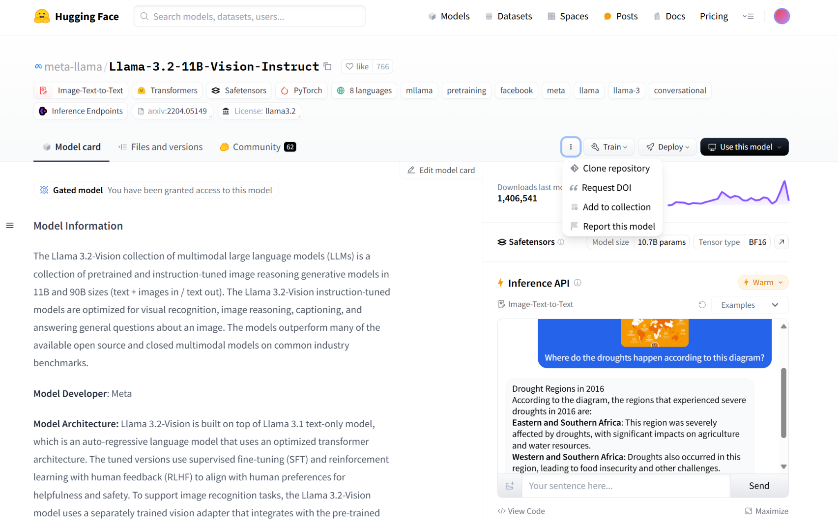
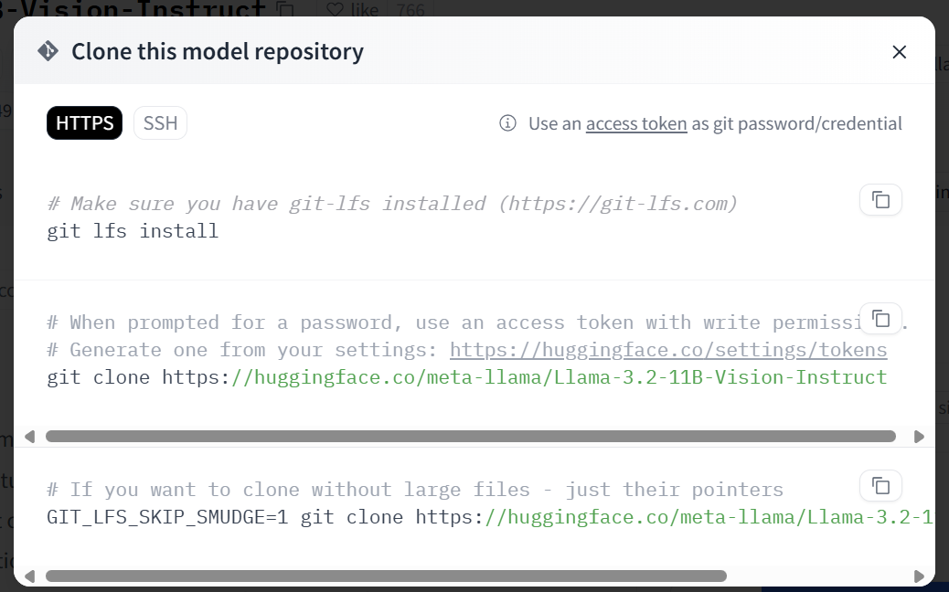
Inference Endpoint for LLM/SLM
Download the model files

Slide 19
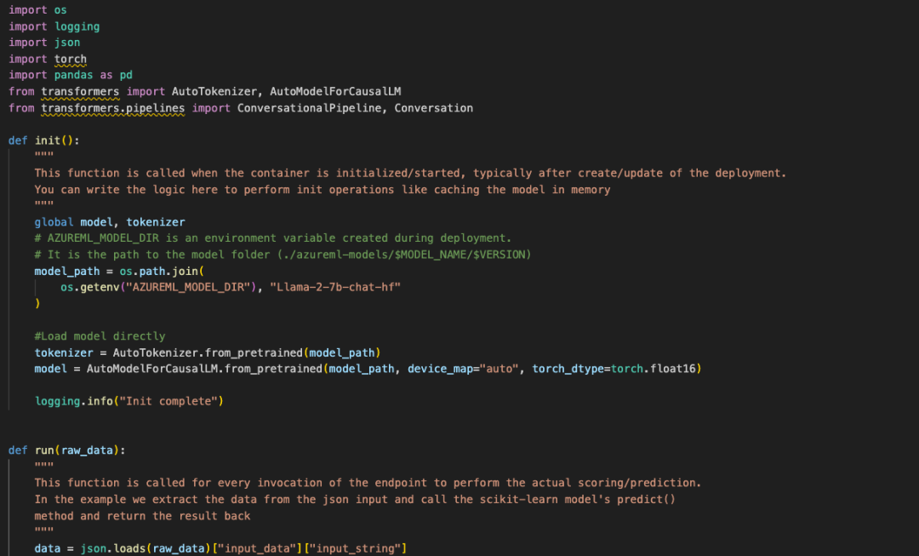
Inference Endpoint for LLM/SLM
2. Setup the DockerFile for Conda environment
3. Setup Scoring Script, it contains the init and run menthod
4. Create realtime endpoint

Slide 20
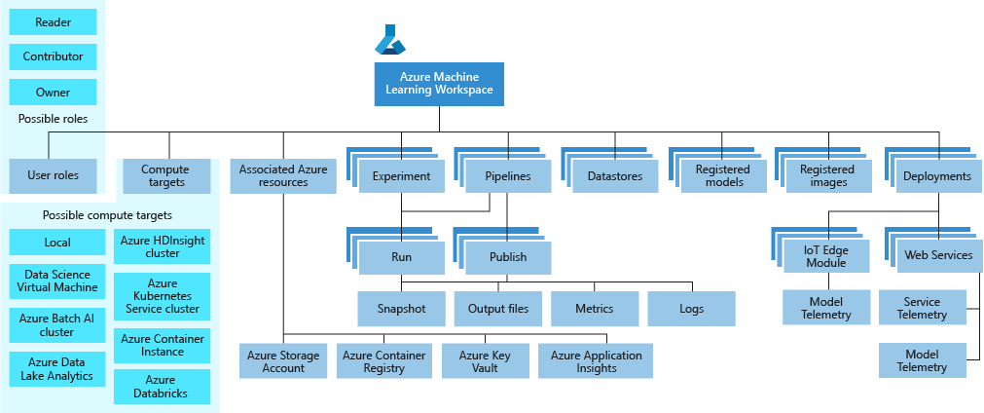
Azure ML service Workspace Taxonomy

Slide 21
Compute Targets
Understand compute targets - Azure Machine Learning | Microsoft Learn
Compute Target for Training | Automated machine learning | Machine learning pipelines | Azure Machine Learning designer
Local computer | Yes
Azure Machine Learning compute cluster | Yes | Yes | Yes
Azure Machine Learning serverless compute | Yes | Yes | Yes
Azure Machine Learning compute instance | Yes (through SDK) | Yes | Yes
Azure Machine Learning Kubernetes |  | Yes | Yes
Remote VM | Yes | Yes
Apache Spark pools (preview) | Yes (SDK local mode only) | Yes
Azure Databricks | Yes (SDK local mode only) | Yes
Azure Data Lake Analytics |  | Yes
Azure HDInsight |  | Yes
Azure Batch |  | Yes
Compute Target for Inference | Used for | GPU support | Description
Azure Machine Learning endpoints | Real-time inference Batch inference | Yes | Fully managed computes for real-time (managed online endpoints) and batch scoring (batch endpoints) on serverless compute.
Azure Machine Learning Kubernetes | Real-time inference Batch inference | Yes | Run inference workloads on on-premises, cloud, and edge Kubernetes clusters.

Slide 22
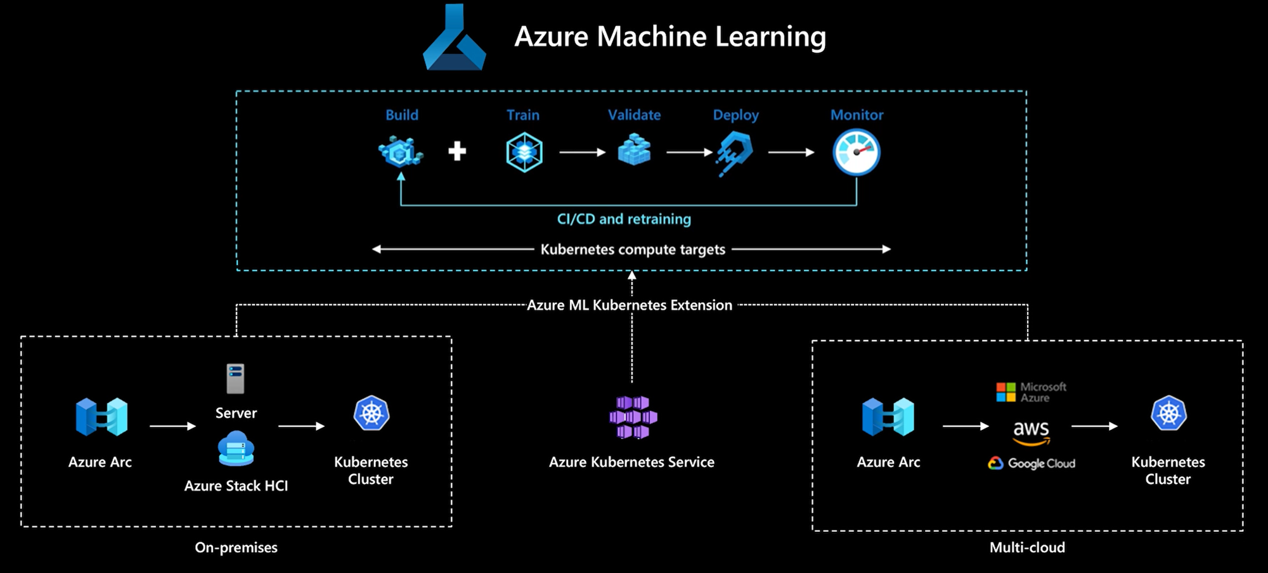
Machine learning anywhere

Slide 23




Assess the model performance
Evaluate your model performance at different phases, using a variety of evaluation approaches
Model benchmarks
Compare publicly available metrics across models and dataset
Manual evaluations
Rate your model responses
Traditional machine learning metrics
Measure ratio of number of shared words between generated and ground truth answers
AI-assisted met
Risk and safety metrics
Generation quality metrics

Slide 24
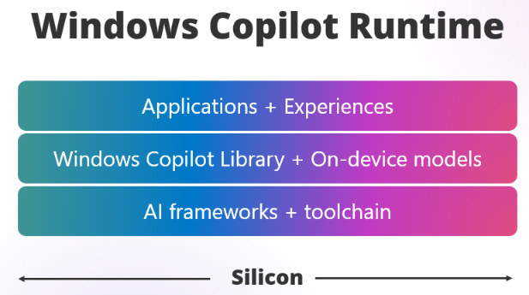




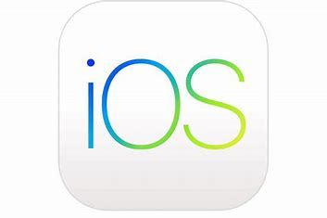


The opportunity of SLMs apps and devices
Small Language Models
On Cloud
On Edge
Mobile • Edge
(iOS, Android)
aka.ms/wcr

Slide 25
Bring AI experiences to your apps and devices
ONNX Runtime
ONNX Runtime + Olive
ONNX Runtime + Azure EP
High performance, portable & cross plat
Open source, extensible framework
Enables Hybrid inferencing
Build in your preferred framework once, and it is available cross platform
Optimizes the model for desired HW! Eliminates the need for deep knowledge
Single API. You choose when to leverage the power of cloud or client.
Get started today! Run AI models on the client devices with NPUs, CPUs and GPUs or hybrid with Azure leveraging ONNX Runtime & Olive
Less engineering effort, better performance
Eases the burden on developer
Developer is in control of UX, resources & costs

Slide 26






Optimization and performance ONNX runtime
Application
Execution provider
Company
Azure​ | Microsoft​
QNN​ | Qualcomm​
OpenVino​ | Intel​
Vitis​ AI | AMD​
DirectML​ | Microsoft​
WebNN​ | Microsoft, Intel​
ONNX
Runtime
CPU-EPs
GPU-EPs
NPU-EPs
ORT Web
Azure-EP
Device
Cloud
Azure
CPU
GPU
NPU

Slide 27


Optimize the deployed model with Olive Toolchain
Deployment ready model package produced:
ORT with chosen EP
Optimized model(s)
Optimal ORT configuration info
Sample boilerplate code
Olive
Olive provides model conversion, compression, optimization techniques targeting a variety of hardware accelerators
Enables model optimization fitting to:
Vitis AI EP (AMD),
OpenVino EP (Intel),
QNN EP (Qualcomm), and
DirectML EP (Windows)
Quantization
Compilation
NAS/Distillation
Model
Target-Specific
Olive Config file
(i.e. designates IHV target, production requirements)
Hybrid-Aware
ONNX conversion

Slide 28
The Microsoft Developer Hybrid Loop
Cloud+Edge ML platform built on heterogenous hardware
Compile
Deploy
Run
Olive
Cloud
ORT
API
ONNX
Model Package
Container
Registry
Quantization
Hardware Providers
Inference Engine
Compilation
NAS/Distillation
Device (Windows, iOS, Android & Linux)
ORT
API
Azure Machine Learning
Applications
Target-Specific
ONNX
Model Package
App Stores
Capabilities Detection
Model Gating/Routing
Hybrid-Aware
Hardware Providers
Inference Engine
ONNX conversion

Slide 29




Choosing the right model
Use case specificity
Identify the complexity of the task
Determine the need for nuanced understanding and generation
Consider the diversity of languages and dialects required
Available resources
Assess computational power and infrastructure
Evaluate budget constraints for training and deployment
Consider energy consumption and sustainability goals
Deployment environment
Consider the feasibility of deploying on edge devices
Evaluate the need for scalability and flexibility
Assess the ease of integration with existing systems
Desired performance
Define acceptable levels of accuracy and coherence
Balance between speed and quality of responses
Determine the importance of real-time processing capabilities

Slide 30
The importance of model benchmarks in AI development
Categories | Mistral-7b | Gemma-7b | Llama-3-8B-In | Mixtral-8x7b | Phi-3-Mini-4K-In | Gemini 1.0 Pro | Phi-3-Small-8K-In | Mistral- 8x22B | Phi-3-Medium-4K-In
Code generation | 39.4 | 42.8 | 64.1 | 49.0 | 56.5 | 68.8 | 66.4 | 55.2 | 68.7
Factual knowledge | 75.2 | 72.3 | 67.7 | 82.2 | 64.0 | 80.2 | 58.1 | 84.5 | 73.9
Language understanding | 52.8 | 49.3 | 64.2 | 62.8 | 64.8 | 70.2 | 67.6 | 72.1 | 69.1
Math | 46.4 | 59.8 | 77.4 | 64.7 | 82.5 | 80.4 | 89.6 | 83.8 | 91.0
Popular aggregate benchmarks | 51.4 | 55.1 | 53.3 | 61.8 | 59.3 | 63.8 | 66.6 | 70.7 | 69.9
Reasoning | 70.3 | 69.1 | 75.7 | 77.0 | 77.1 | 80.4 | 82.4 | 81.5 | 84.1
Grand Total | 61.2 | 61.7 | 69.4 | 69.8 | 70.4 | 75.4 | 75.7 | 76.3 | 78.5

Slide 31
Considerations when selecting a model
AI quality
Task compatibility
Performance metrics
Data requirements
Computational efficiency
Ethical considerations
Community support and documentation
Customizability
Features
Price (Cost/Latency)

Slide 32


Find, customize, and operationalize models at scale
Everything you need to build unique Gen AI experiences that scale
Discover
Innovate with your best models
Model Catalog & Evaluations
Azure OpenAI Service
Models as a Service
Fine-tune
Differentiate with your own data
Azure AI Search
Microsoft OneLake
Azure AI Services
Evaluate
Safeguard with custom systems
Azure AI Content Safety
Microsoft Purview
Microsoft Defender
Deploy
Operationalize with developer agility
Azure AI Prompt Flow
GitHub Enterprise
Visual Studio Code
Azure AI Studio
Azure Infrastructure

Slide 33
Infrastructure Cost Consideration

Slide 34



















End-to-end Cloud Native path
Community
Security
AI
Microsoft Entra ID
Azure Policy
Microsoft Defender
AI Services
OpenAI
Machine Learning
Development tools
Platform
Managed databases
Storage
GitHub
Azure MySQL & MariaDB
Azure Kubernetes Service
Azure Kubernetes Fleet Manager
Azure PostgreSQL
Azure Cosmos DB
Azure SQL family
Azure Storage
Visual Studio Code
Azure API Management
Cloud operations anywhere
Azure Container Registry
Azure Arc

Slide 35
AI Application Architecture
The AI service is one building block in your application architecture. Your business requirements drive your application architecture decisions for performance, resiliency, business continuity & disaster recovery.
Quota
BCDR requires
Model processing capacity (endpoint)
Input size
Output size
Call rate
Cache match rate
Per-call latency
Model type
Tokens in prompt
Tokens generated
Overall load on system
Azure OpenAI resources in different regions
Custom application code to monitor endpoint availability
Manual or automated application changes to redirect to secondary region endpoints
Azure OpenAI: Performance & latency
Azure OpenAI: BCDR

Slide 36










AI Application Architecture Example 1
a
Resource Group
visualize
Azure Managed Prometheus
Azure Managed Grafana
scrape
https://learn.microsoft.com/azure/aks/open-ai-quickstart
OIDC Issuer URL
Azure Kubernetes Services
Namespace name
trust
Federated Credential
Microsoft Entra ID
Petstore Application
Managed Identity Client ID
env vars
ServiceAccount name
Managed Identity Principal ID
assign
Managed Identity Client ID
OpenAI
Cognitive Services OpenAI User
Managed Identity

Slide 37







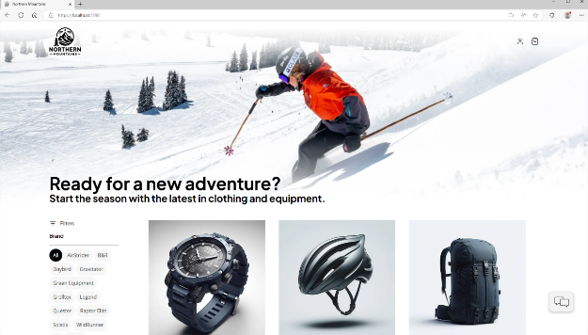


AI Application Architecture Example 2
a
Cloud Services
Client Apps
Identity Service
Mobile BFF
Identity API
PostgreSQL
OpenAI
Mobile App
Catalog Service
Mobile API
Catalog API
PostgreSQL
github.com/dotnet/eshop
github.com/Azure-Samples/ eShopOnAzure
Order Service
Ordering API
Web App
Ordering API
Order Processor
PostgreSQL
Event Bus
Browser
Blazor App
Basket Service
Basket API
Redis
Payment Service
Payment Processor
Admin Services
Webhook Client
Webhooks Service
Observability
Webhooks API
PostgreSQL

Slide 38





AI Application Architecture Example 3
a
1
2
3
4
5
Function app
Upload podcast / view results
REST API for upload and status
User
Static web app
Function (HTTP triggered)
Function (Blob triggered)
Transcribe audio file
Function (Blob triggered)
Generate synopsis, tag line, SEO keywords
https://learn.microsoft.com/azure/architecture/ai-ml/idea/process-audio-files
Save audio file to Azure Storage
Azure AI Services
Azure OpenAI GPT
Speech to text
Storage
raw-files container
transcription container
open-ai-results container

Slide 39
Infrastructure cost considerations
a
AKS – application autoscaling, cluster autoscaling, node scaling, etc.
Serverless costs – Azure Functions etc.
Availability zones
Storage
Load balancing
Networking
Security products
Monitoring (e.g. sending data to Azure Monitor Logs)
Backups

Slide 40
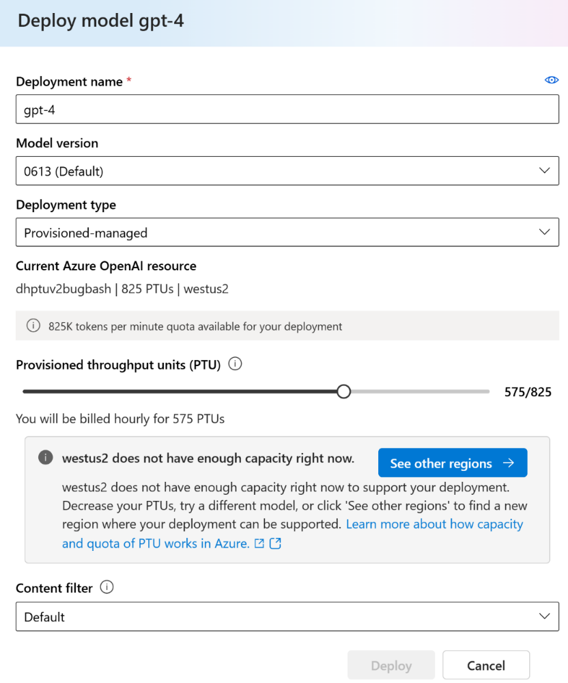
New! Provisioned Offering Self-service purchasing
Provisioned self-service quota management:
Easy quota requests via a user-friendly form
Quick auto-approval process to expedite deployment
Flexible model usage:
Quota can be used for any model/version, enhancing flexibility
Default quota allocated in all supported regions for ease of access
Real-time capacity insights:
Transparent access to regional service capacity for better planning
Guided deployment experience offers alternative regions if capacity is full
Incorporate new reservation model:
Discounted Azure Reservations for monthly and yearly commitments
Optional for hourly billing with no-commitment for simplified workload testing and migrations

Slide 41
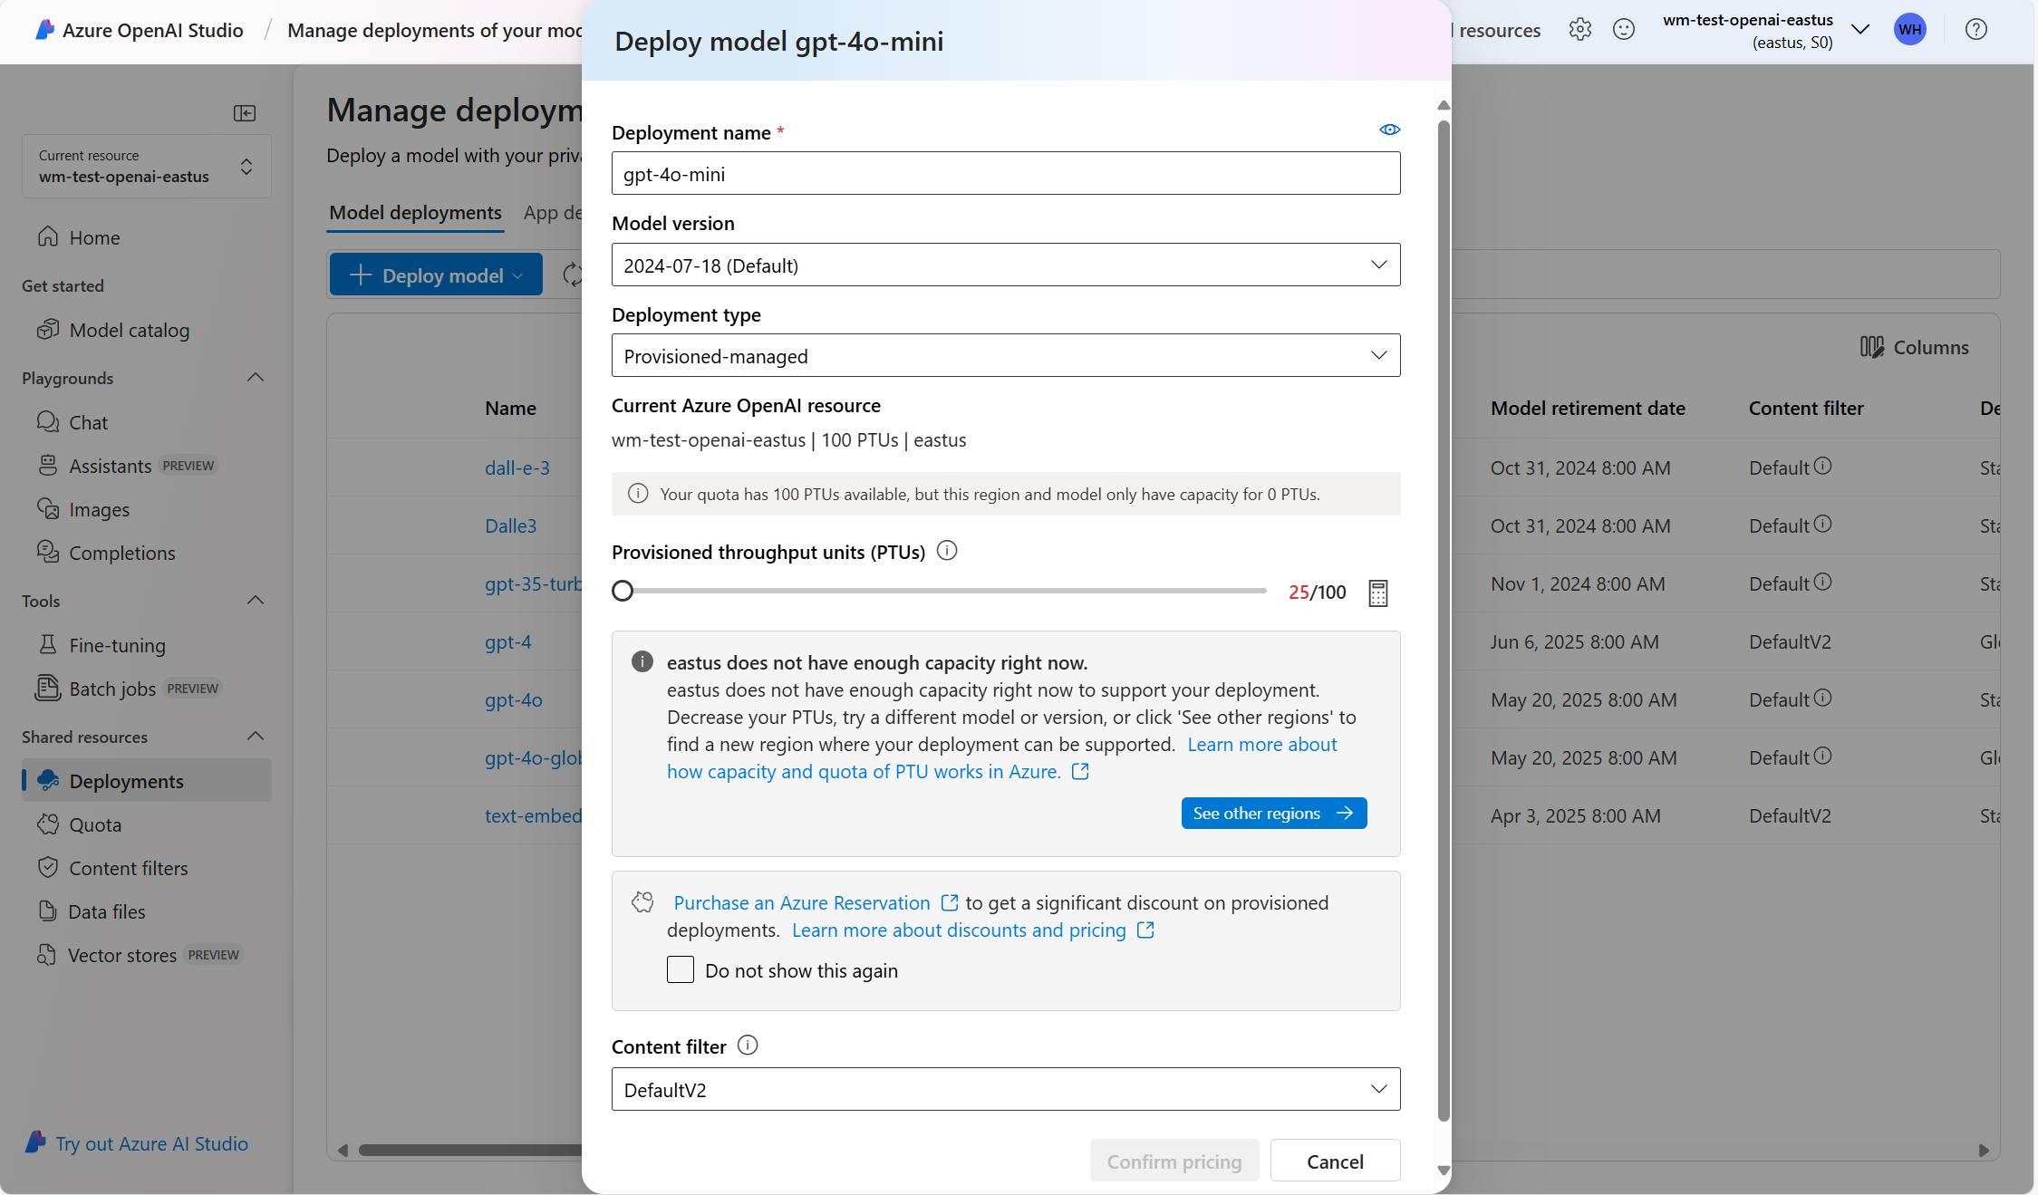

Slide 42
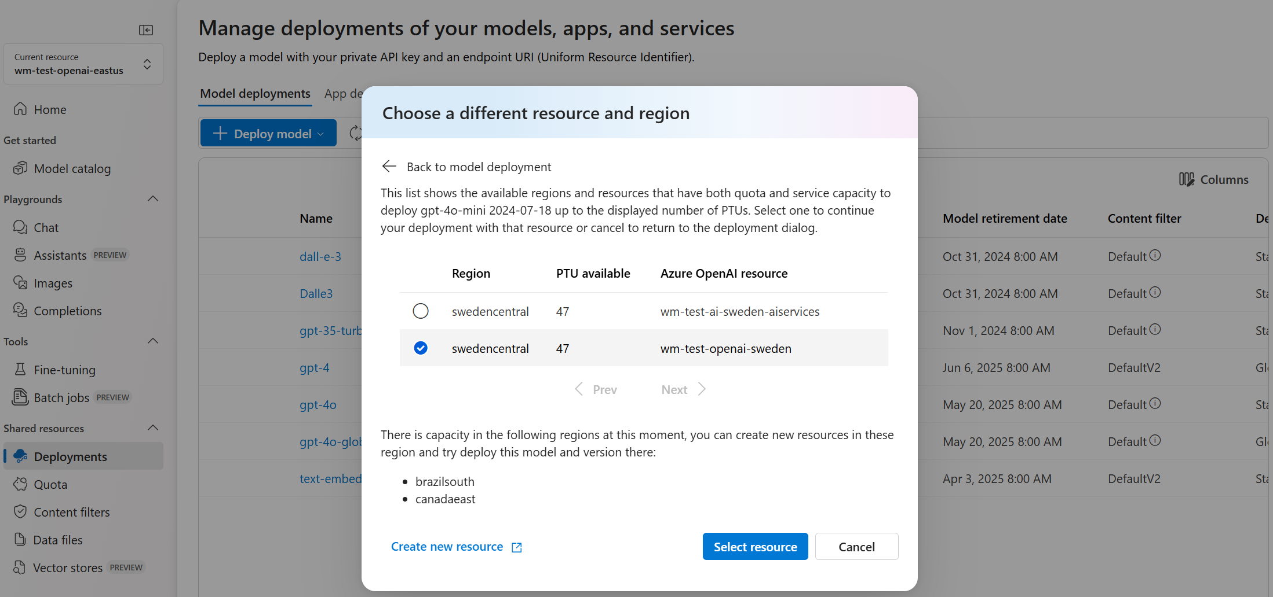

Slide 43
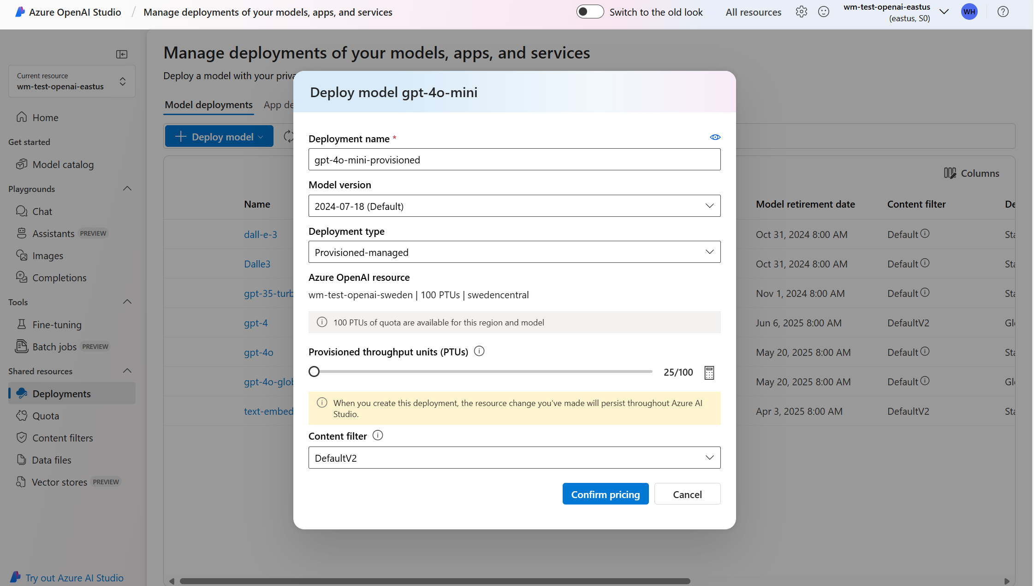

Slide 44
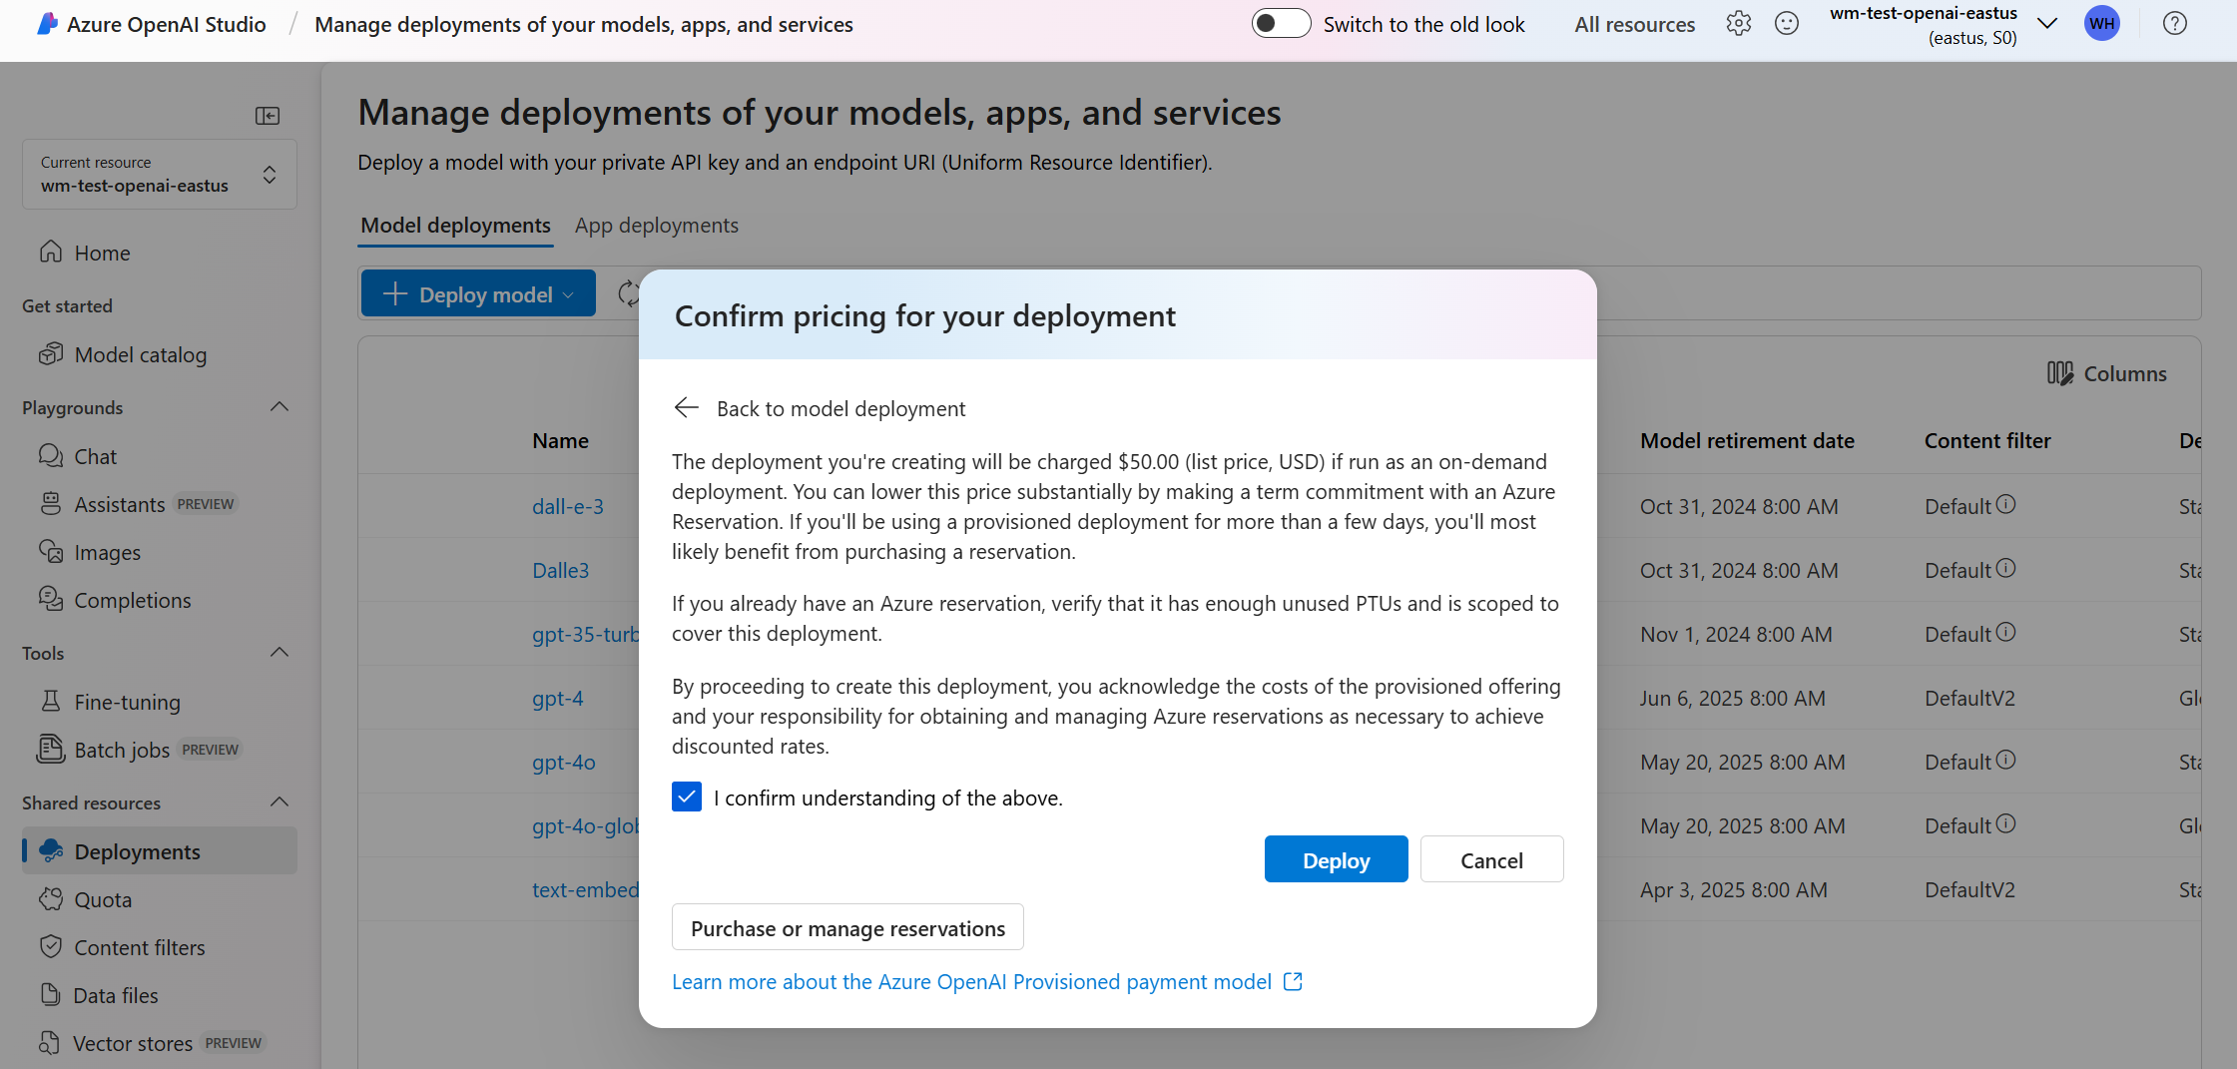

Slide 45
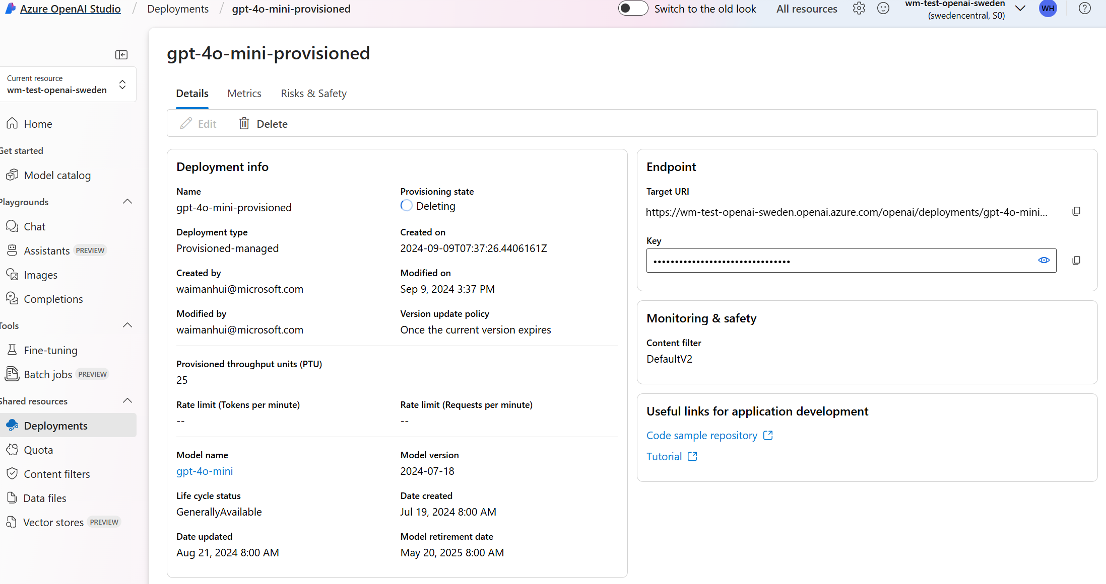

Slide 46
Choosing the best offer
Standard
Provisioned
Flexible deployment options |  | Easy access with high and predictable throughput
Optimized for low to medium volume workloads |  | Real-time scoring for large consistent volume
Pay-per-call flexibility |  | High volume w/consistent low latency
GOOD FOR: Low to medium volume workloads Intermittent usage scenarios Use cases resilient to throughput variability or slowness when service is busy Global or Regional deployment options with inherent data residency policies Sandbox/test environment |  | RECOMMENDED FOR: Production workloads High volume workloads Throughput heavy workloads Latency sensitive scenarios Regional deployments

Slide 47
Provisioned pricing
Offers you the benefit of flexible and scalable deployment with predictable costs and streamlined billing with significant discounts*
Provisioned | Price
Model and minimum scaling increment |  | Monthly cost per model increment | 1-Year RI Effective Monthly Cost per Model Increment
Current GA models
GPT-4o: 2024-08-06 | 50 units | $13,000 | $11,050
GPT-4o mini: 2024-07-18 | 25 units | $6,500 | $5,525
GPT-4o: 2024-05-13 | 50 units | $13,000 | $11,050
GPT-4-Turbo: 0409 | 100 units | $26,000 | $22,100
Legacy models**
GPT-4: 0613 (32K) | 200 unit | $52,000 | $44,200
GPT-4: 0613 (8K) | 100 units | $26,000 | $22,100
GPT 3.5-Turbo: 0125 | 50 units | $13,000 | $11,050
GPT-3.5-Turbo: 1106 | 50 units | $13,000 | $11,050
Hourly |  | $2/PTU/hr
Reservations
 | One month | $260/PTU/mo
 | One year | $2,652/PTU/yr or $221/PTU/mo
*Customers who intend long-term usage of PTUs may receive a significant discount on the hourly rate by purchasing an Azure Reservation for Provisioned.
***Note retirement dates for legacy models: Azure OpenAI Service model retirements - Azure OpenAI | Microsoft Learn. Use in-portal Capacity Calculator oai.azure.com/portal/calculator. GPT-4 models are in the processing of upgrading to 0409. All pricing in USD above dated on June 18, 2024, are subject to change.

Slide 48
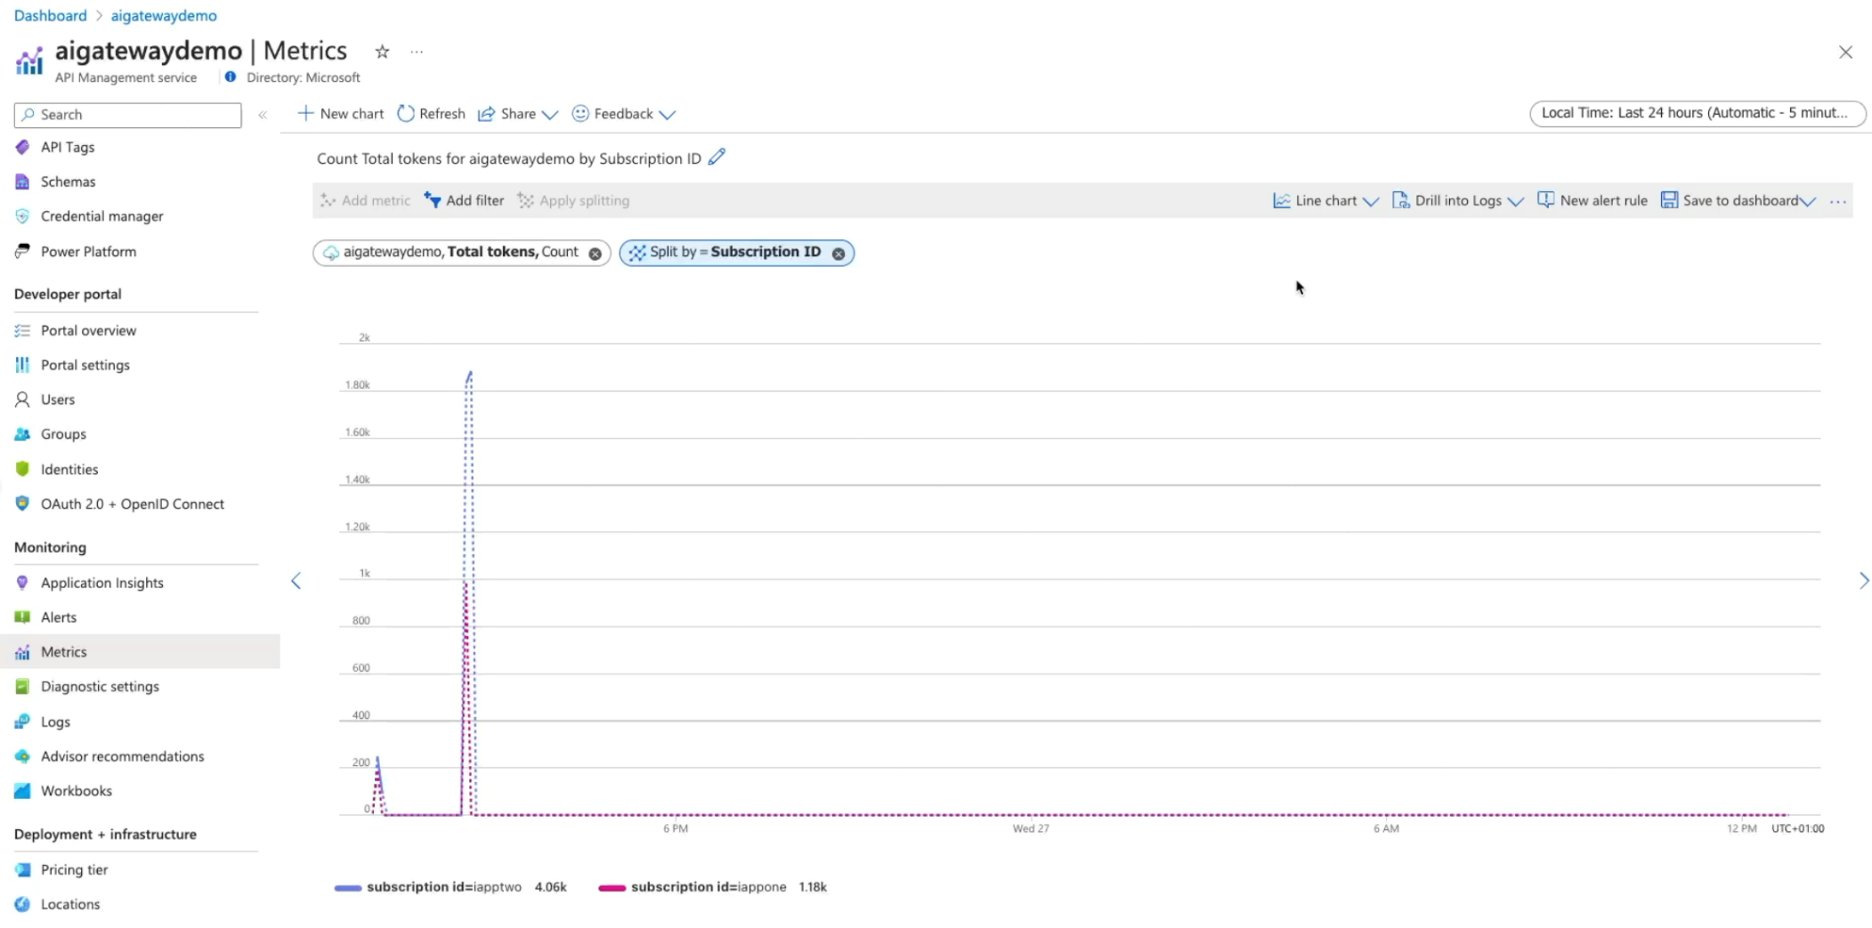

GenAI gateway features in Azure API Management
Generally Available
GenAI Gateway with Azure API Management
Centralize management of model and prompt endpoints
Load balance across OpenAI endpoints, PTU/PAYG, and different models
Track token consumption and attribution for streaming and non-streaming requests
Improve performance and conserve tokens with semantic caching
Secure access to models with Managed Identity
Public preview
Guide: https://aka.ms/genai-gateway
Landing zone accelerator: https://aka.ms/apim-genai-lza

Slide 49
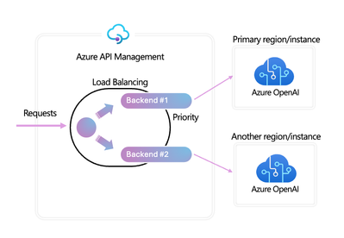
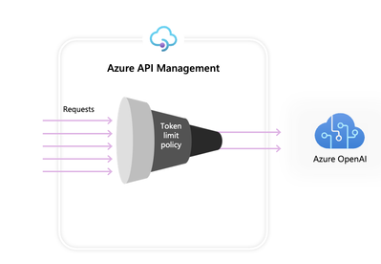
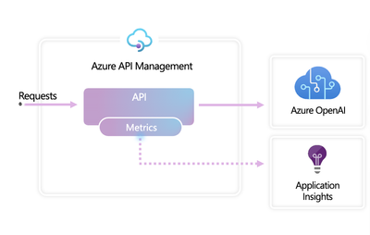
GenAI gateway features in Azure API Management
Load Balancer and Circuit Breaker
Azure OpenAI Token Limit policy
Azure OpenAI Token Metric policy
Distribute requests across PTU and Pay-as-you-go instances
Configure tokens per minute (TPM) limits based on counter keys
Facilitate accurate cross-charging based on token consumption
Define load balancing pools to include multiple Azure OpenAI endpoints
Define similarity score threshold for caching
Collect token usage data
policy.xml
policy.xml
Configure circuit breaker rules for successful failover
<azure-openai-token-limit
counter-key="@(context.Subscription.Id)" tokens-per-minute="1000"
estimate-prompt-tokens="false" />
<azure-openai-emit-token-metric
namespace="AzureOpenAI">
<dimension name="User ID" />
<dimension name="Subscription ID" />
</azure-openai-emit-token-metric>
https://github.com/Azure-Samples/AI-Gateway

Slide 50
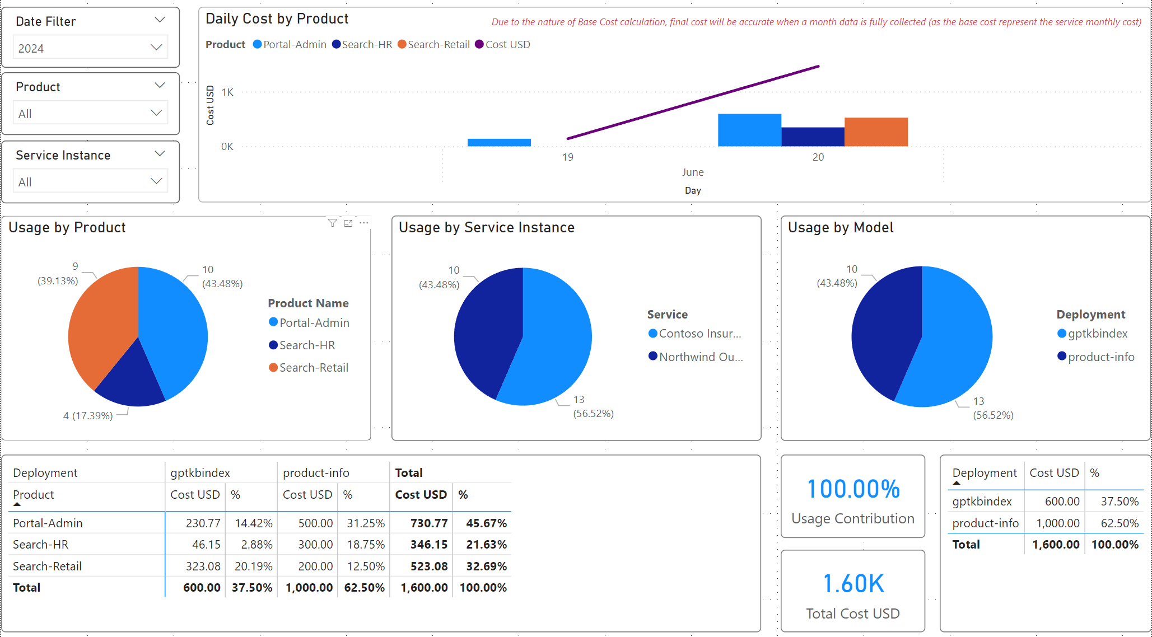
Calculating Chargeback for BU/Projects
https://github.com/Azure-Samples/ai-hub-gateway-solution-accelerator

Slide 51
Latest Updates

Slide 52
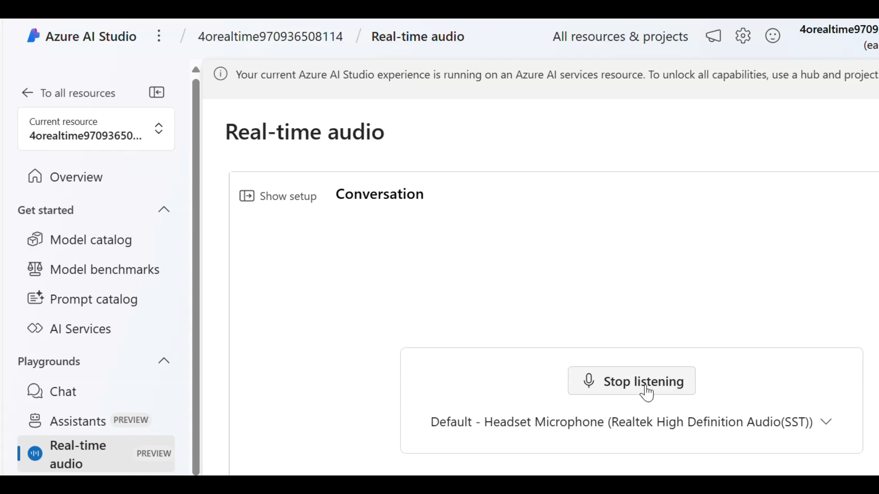

Slide 53
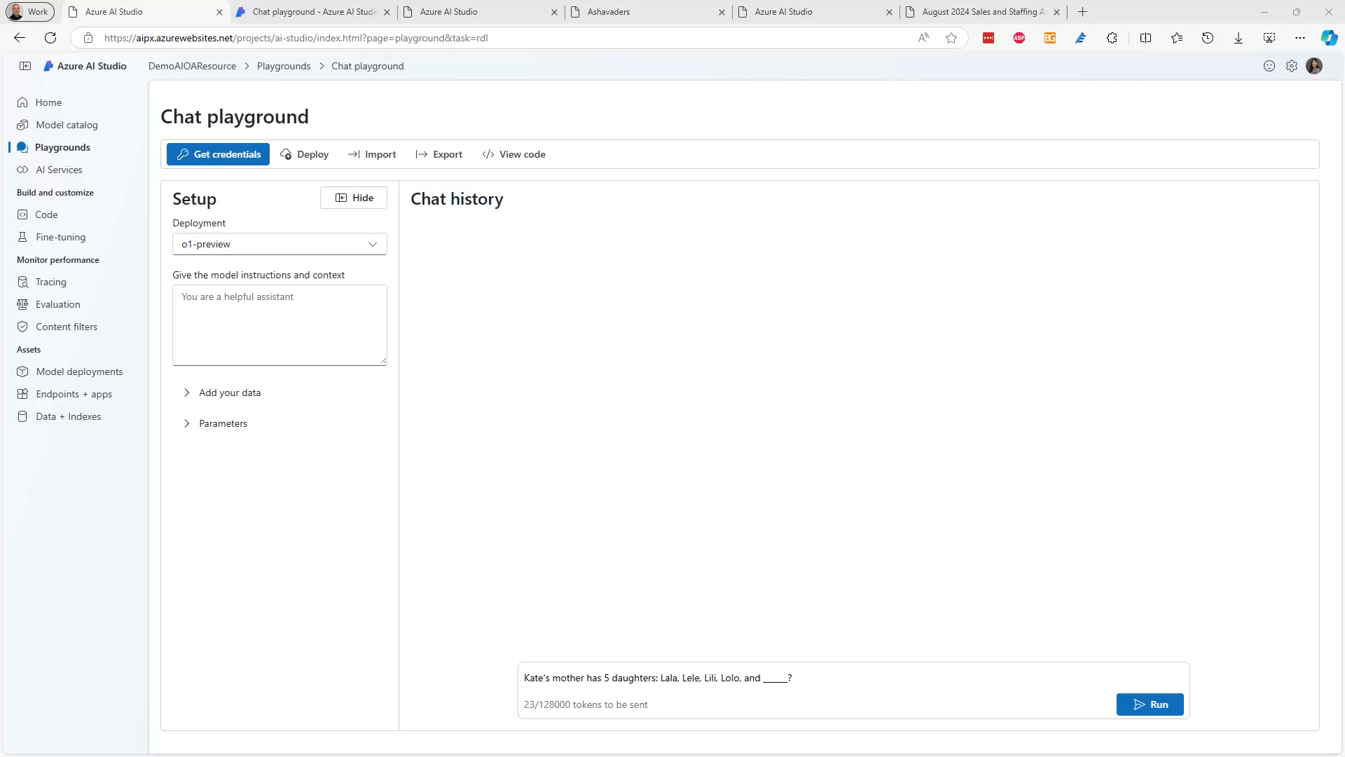

Slide 54







Introducing Video Translation
Now available in public preview!
Localization
Video translation covering global locales
Quality
GPT built-in to optimize the translation content, augmented by content editing
Personalization (limited access)
Keep the original timbre, emotions, intonation & style intact of the original speaker
Batch processed
Video Input
Speech-to-Text
Translation
Content Editing
Text-to-Speech
Output Video
Optional and for prebuilt voices only

Slide 55

Video translation overview - Speech service - Azure AI services | Microsoft Learn

Slide 56

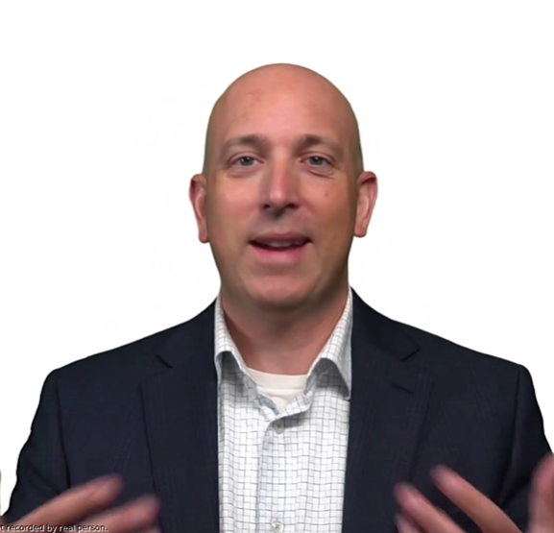





Text to speech avatar
Now GA!
Prebuilt avatar
Custom avatar
Use our prebuilt avatar in content generation or interactive scenarios
Build your own branded avatar with us by providing 10 mins video recording
2D Photorealistic digital humans. The future of virtual interactions
Limited data, maximum output. Our avatar models are trained with minimal video recordings
Text-triggered responses. Create scripts with natural language
Multilingual capabilities. High-quality neural TTS and custom neural voices for global reach
Batch or real-time streaming available
Use cases
Customer service
Live chatbot
Training video
Conference speech
CEO/leader avatar
Promote brand
Live streaming
Ads

Slide 57


Slide 58
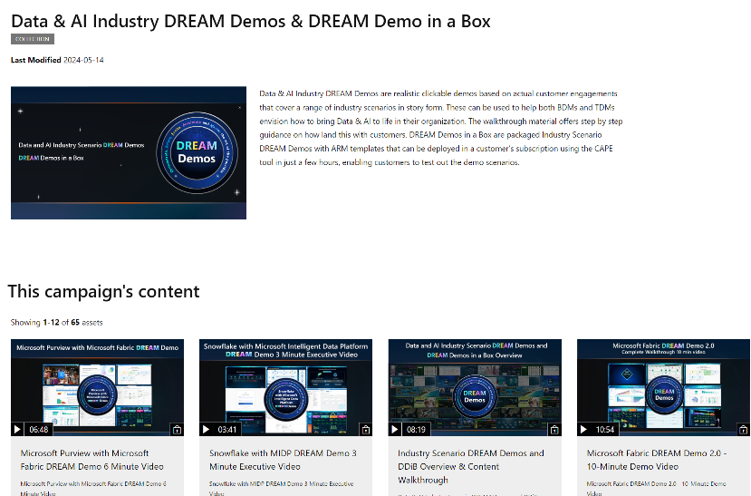
Self Learning Resource
Accelerating AI Solutions Bootcamp
Technical Skilling
Certification
Data & AI Industry DREAM Demos & DREAM Demo in a Box

Slide 59





AI Design Wins – Skilling Curriculum 30-60-90-DAY JOURNEY
Understand Microsoft's AI ecosystem and its Azure AI, Data and Application services.
Design and create AI solutions using Microsoft Azure services, focusing on specific Azure AI and App services.
Implement & Deploy advanced AI applications and data solutions in production environments using Microsoft's suite of tools and services.
Business Executives | AI-3017: AI for Business Leaders* Transform your business with Microsoft AI Discover Microsoft AI for Leaders by Industry (Healthcare, Finance, Retail, Manufacturing & Sustainability)
AI Engineers | AI-900: AI Fundamentals AI-050: Develop Generative AI Solutions with Azure OpenAI Service AI-3018: Copilot Foundations* Introduction to Azure AI Studio (Preview) Work with generative artificial intelligence (AI) models in Azure Machine Learning | AI-102: Designing and Implementing a Microsoft Azure AI Solution AI-3002: Create document intelligence solutions with Azure AI Document Intelligence AI-3003: Build NLP processing solutions with Azure AI Services AI-3004: Build an Azure AI Vision solution with Azure AI Services | AI-3016: Develop Copilots with Azure AI Studio* AI-3019: Build AI Apps with Azure Database for PostgreSQL*
Data Scientists | DP-900: Fundamentals DP-100: Designing and Implementing a Data Science Solution on Azure Introduction to AOAI service Work with generative artificial intelligence (AI) models in Azure Machine Learning | DP-3007: Train and deploy a machine learning model with Azure Machine Learning | DP-3014: Implementing a Machine Learning solution with Azure Databricks DP-604: Implement a data science and machine learning solution for AI with Microsoft Fabric
Developer/ Data Analyst/ Engineer | AZ-2008: DevOps Foundations: The Core Principles and Practices | AZ-204: Developing Solutions for Microsoft Azure AZ-1001: Deploy and manage containers using Azure Kubernetes Service AZ-2003: Deploy cloud-native apps using Azure Container Apps AZ-2005: Develop AI agents using Azure* OpenAI and the Semantic Kernel SDK DP-203: Data Engineering on Microsoft Azure AZ-2002: Develop an ASP.NET Core web app that consumes an API PR-801: Modernize and Build AI Apps | DP-3012: Implementing a Data Analytics Solution with Azure Synapse Analytics DP-3015: Getting Started with Cosmos DB NoSQL Development* PR-802: Power Business Decisions with Cloud-Scale Analytics DP-420: Designing and Implementing Cloud-Native Applications Using Micros AZ-400: Designing and Implementing Microsoft DevOps Solutions DP-3011: Implementing a Data Analytics Solution with Azure Databricks DP-600: Microsoft Fabric Analytics Engineer DP-601: Implementing a Lakehouse with Microsoft Fabric DP-602: Implementing a Data Warehouse with Microsoft Fabric DP-603: Implement Real-Time Analytics with Microsoft Fabric PL-7008: Create copilots with Copilot Studio* PR-701: Migrate Enterprise Applications
Personas

Slide 60
GenAI Ops

Slide 61
Get to
know
Azure AI
Azure AI Studio
One place for building and deploying AI solutions
Model
Catalog
Complete AI
Toolchain
Responsible AI
Practices
Enterprise-Grade Production at Scale
Cutting-Edge Models
Access to the latest foundation and open-source models
Model
Catalog
Models
As a Service
GPT Model
Family
Open-Source
Models
Small Language Models
Azure AI Infrastructure
State-of-the-art silicon and systems for AI workloads
Azure AI Services​
Pre-trained, turnkey solutions for intelligent applications
Azure OpenAI Service​
Azure AI Search
Azure AI Speech
Azure AI Vision
Azure AI Content Safety
Azure AI Document
Intelligence
Azure AI Language
Azure AI Translator
High-Bandwidth Networking
Azure Machine Learning
Full-lifecycle tools for designing and managing responsible AI models
Microfluidic Cooling
Azure Maia Silicon
Prompt Flow
Orchestration
Responsible
Model Design
Model
Fine-Tuning
Model
Training

Slide 62

The paradigm shift — from MLOps to GenAIOps
Traditional MLOps
GenAIOps
Audiences
ML Engineers
Data Scientists
ML Engineers
App developers
Assets to share
Model, data, environments, features
LLMs, agents, plugins, prompts, chains, APIs
Quality: accuracy, similarity Harm: bias, toxicity Honest: groundness Cost: token per request Latency: response time, RPS
Metrics/evaluations
Accuracy
ML models
Build from scratch
Pre-built, fine-tuned served as API (MaaS)

Slide 63
LLM Lifecycle in the real world
Managing
PREPARE FOR APP DEPLOYMENT
ADVANCE PROJECT
Prompt Engineering or Fine-tuning
Find LLMs
Retrieval Augmented Generation
Quota and cost management
Safe Rollout/Staging
Try prompts
Hypothesis
BUSINESS NEED
Monitoring
Deploy LLM App/UI
Ideating/ exploring
Building/ augmenting
Exception Handling
Operationalizing
Evaluation
Content Filtering
REVERT PROJECT
SEND FEEDBACK

Slide 64
What does good answers look like?
Are they clear and understandable?
Are they correct? (relative to the knowledge base)
Are they formatted in the desired manner?
Yes, according to the information provided in the PerksPlus.pdf document, underwater activities such as scuba diving are covered under the program.
Do the perks cover underwater activities?
Yes, the perks provided by the PerksPlus Health and Wellness Reimbursement Program cover a wide range of fitness activities, including underwater activities such as scuba diving. The program aims to support employees' physical health and overall well-being, so it includes various lessons and experiences that promote health and wellness. Scuba diving lessons are specifically mentioned as one of the activities covered under PerksPlus. Therefore, if an employee wishes to pursue scuba diving as a fitness-related activity, they can expense it through the PerksPlus program.
Yes, underwater activities are included as part of the PerksPlus program. Some of the underwater activities covered under PerksPlus include scuba diving lessons [PerksPlus.pdf#page=3].

Slide 65
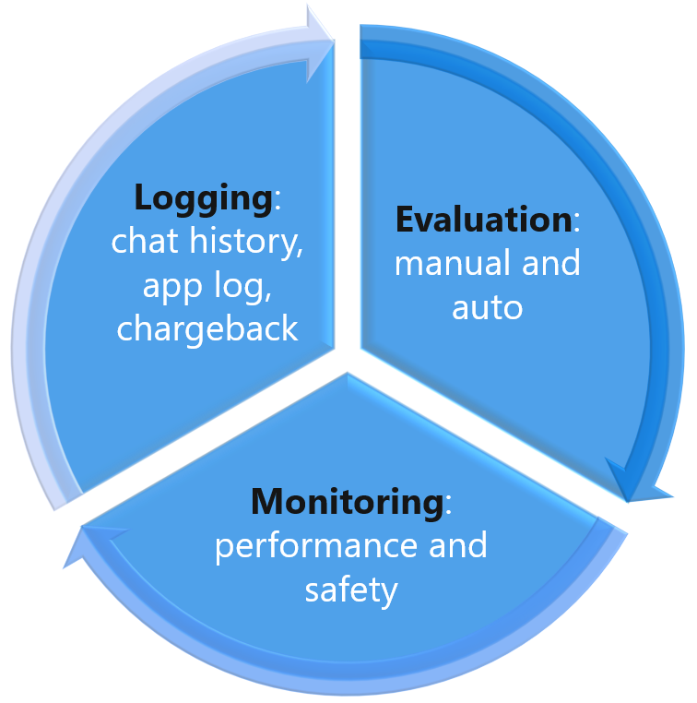
What affects the quality?
Large Language Model
Question
Search
Search engine (ie. Azure AI Search)
Search query cleaning
Search options (hybrid, vector, reranker)
Additional search options
Data chunk size and overlap
Number of results returned
Data Quality
System prompt
Language
Message history
Model (ie. GPT 3.5)
Temperature (0-1)
Max tokens

Slide 66
Experience Sharing – the 5 Step
Drive test cases from requirement spec. (eg. 10 requirements)
Define max number of questions for each requirement. (e.g. 3 questions for each requirement, ie. 3 x 10 = 30). Prepare the test dataset.
Define the relevant metrics (e.g. groundedness, relevance, latency) and agree on the acceptance criteria. Enable tracing
Iteration: Execute the test cases, evaluate, analyse and keep track the metric
Continuous monitoring after golive

Slide 67
Evaluation
Send queries to app
Generate app outputs
Manual Evaluation
Evaluate app outputs
Automatic Evaluation:
AI-Assisted Measurements
Metrics
Performance and quality
Risk and safety
Custom

Slide 68
Performance and quality metrics
Groundedness
Measures how well the model's generated answers align with information from the KB or input source
Relevance
Measures the extent to which the model's generated responses are pertinent and directly related to the given questions
Coherence
Evaluates how well the model can produce output that flows smoothly, and resembles human-like language
Fluency
Evaluates the extent to which the generated text conforms to grammatical rules, syntactic structures, and appropriate vocabulary usage

Slide 69

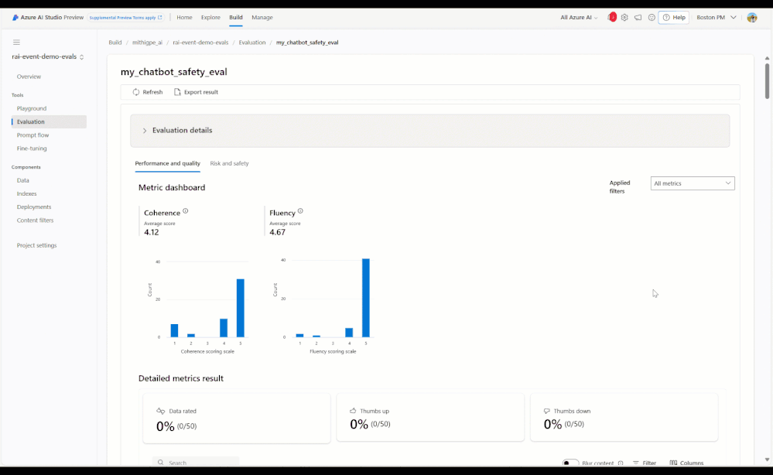
Content Safety evaluation in Azure AI Studio
New
New
Quality
Risk & Safety
Custom
AI-assisted metrics
Groundedness
Coherence
Fluency
Relevance
Retrieval score
GPT Similarity
ML metrics
F1 score
AI-assisted metrics
Jailbreak defect
Hate and Unfairness
Sexual
Violence
Self-Harm
Customize pre-built metrics or build your own metrics using prompt flow

Slide 70
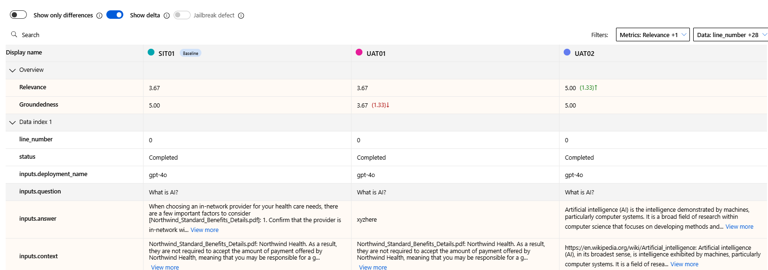
From feeling to number

Slide 71
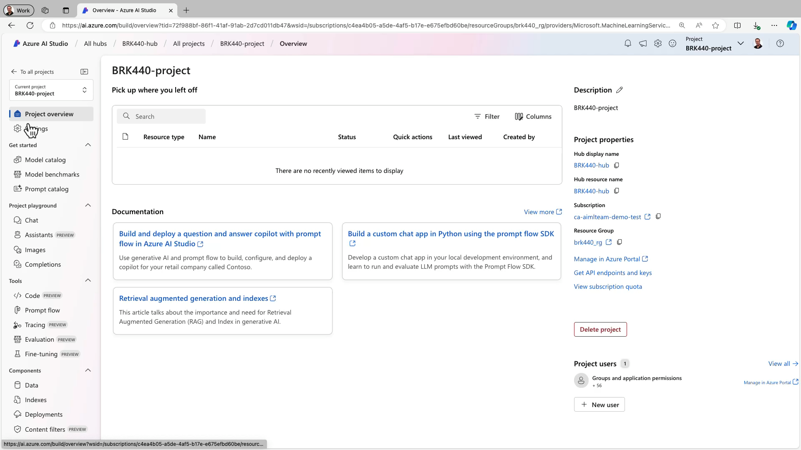
Content Safety

Slide 72
Azure AI Studio2
Everything you need to build unique GenAI experiences
Model discovery
Compare models and data sets across industry-wide benchmarks to optimize them for your scenario
Model customization
Iterate and tailor your model selections through prompt engineering, fine tuning and RAG techniques
Continuous monitoring
Manage anomalies fast in a collaborative environment for prompting, evaluation and real-time deployments
Nimble iteration
Seamlessly evaluate the alignment of your LLM strategies with evolving business objectives

Slide 73
GenAI Security

Slide 74
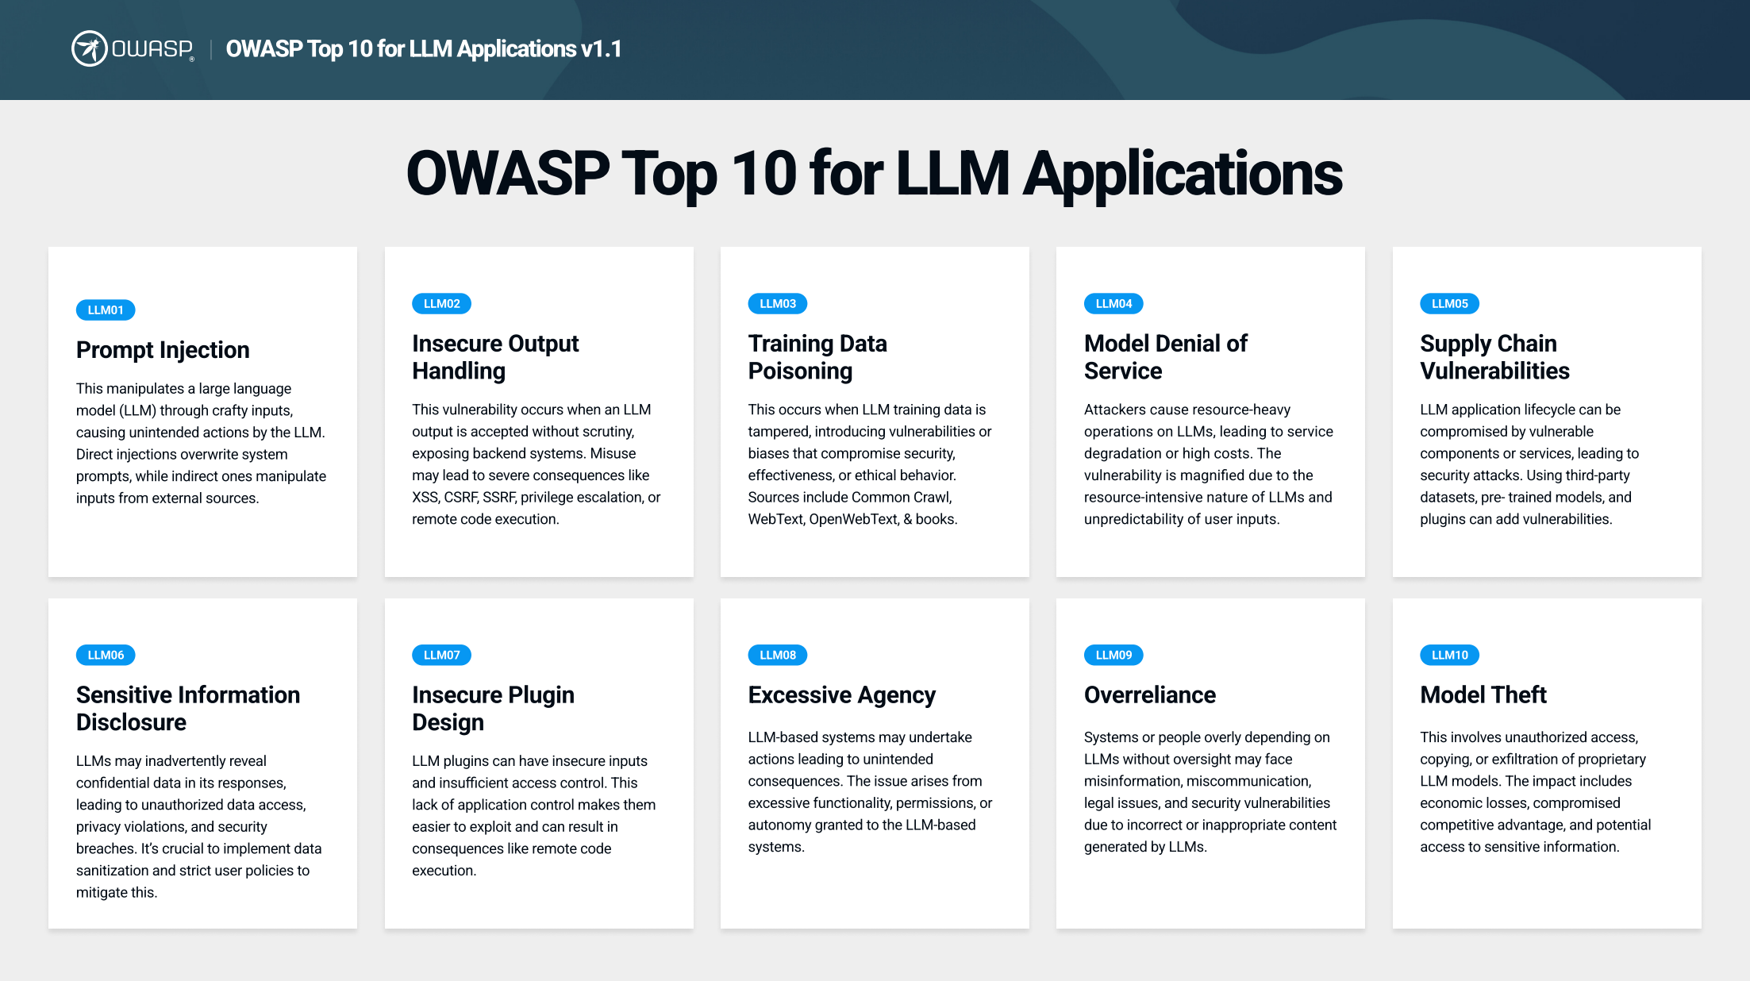
https://genai.owasp.org/

Slide 75
Security Best Practices for LLM Applications in Azure
Category | Best Practice | Example
Data Security | Data Classification and Sensitivity | Use Microsoft Purview to auto classify data
Network Security | Secure APIs and Endpoints | properly secured with authentication and authorization mechanisms, such as API keys or OAuth, to prevent unauthorized access
Access and Identity Security | Role-Based Access Control | grant appropriate permissions to users, groups, or services accessing your LLM application. Follow the principle of least privilege, granting only the necessary permissions for each entity.
Application Security | Monitor and Audit LLM Activity | track LLM activity, detect suspicious behavior

